Slide 1
3. Experiment and Develop DE/ML workflow
Notes:
As of 2/21/2020

Slide 2
Meeting Agenda
Topic | Time | Presenter
Databricks AI assistant | 30 mins | Nara
Using Databricks from IDEs - VSCode, PyCharm | 45 mins | Nara
Delta table | 45 mins | Jake
Unity Catalog | 45 mins | Jake
Unity Catalog (Gilead-DnA infra) | 15mins | Anthony

Slide 3


Meet the Team
To add or arrange timeline elements, manually move and edit text group.
NOTE
Name
Pronoun1/2/3
Job Title
Name
Pronoun1/2/3
Job Title
Name
Pronoun1/2/3
Job Title
Name
Pronoun1/2/3
Job Title
Name
Pronoun1/2/3
Job Title
Name
Pronoun1/2/3
Job Title
Name
Pronoun1/2/3
Job Title
Name
Pronoun1/2/3
Job Title

Slide 4
Databricks AI assistant

Slide 5

92%
U.S.-based developers are already using AI coding tools both in and outside of work.
Source: Beet Roots
70%
say AI coding tools will offer them an advantage at work and cite better code quality, completion time, and resolving incidents
Source: Github blog 2024

Slide 6
Enterprises want to
empower their data and AI developers with natural language tools

Slide 7



AI assistants don’t work on enterprise data
Unable to locate the right data assets
Only generate generic responses
Don’t comply with access policies
AI doesn’t know where to find the relevant tables, pipelines, queries, and dashboards
AI doesn’t understand your unique data structures, usage patterns, or business terminology
AI doesn’t know which users and groups are allowed to see which schemas, tables, and columns
Generalized LLMs lack data intelligence
Notes:
Developers increasing use AI assistants, but they still don’t trust them. Generated answers have various issues that make them hard to use. Let’s dive into why. Because models being used are trained on generic code, it can spit out a solution with code that isn’t relevant or very good for what you are working on. When it does get a line of code right, the data it calls may be invented or not the relevant data for what you are trying to do. Finding the right data for a given task can be more challenging than writing the script, and AI assistants can’t help with this.

Slide 8









Data intelligence gives AI the unique context of your business
Always finds the right data and AI assets
Data Catalog
Recents
Dashboards
Data Intelligence
Generates highly relevant responses
Docs
Popularity
Lineage
Only returns data users approved to see
Notebooks
Queries
Policies
Data intelligence engine uses AI to learn the signals in your data platform
AI assistant gains awareness of your unique data and business context

Slide 9
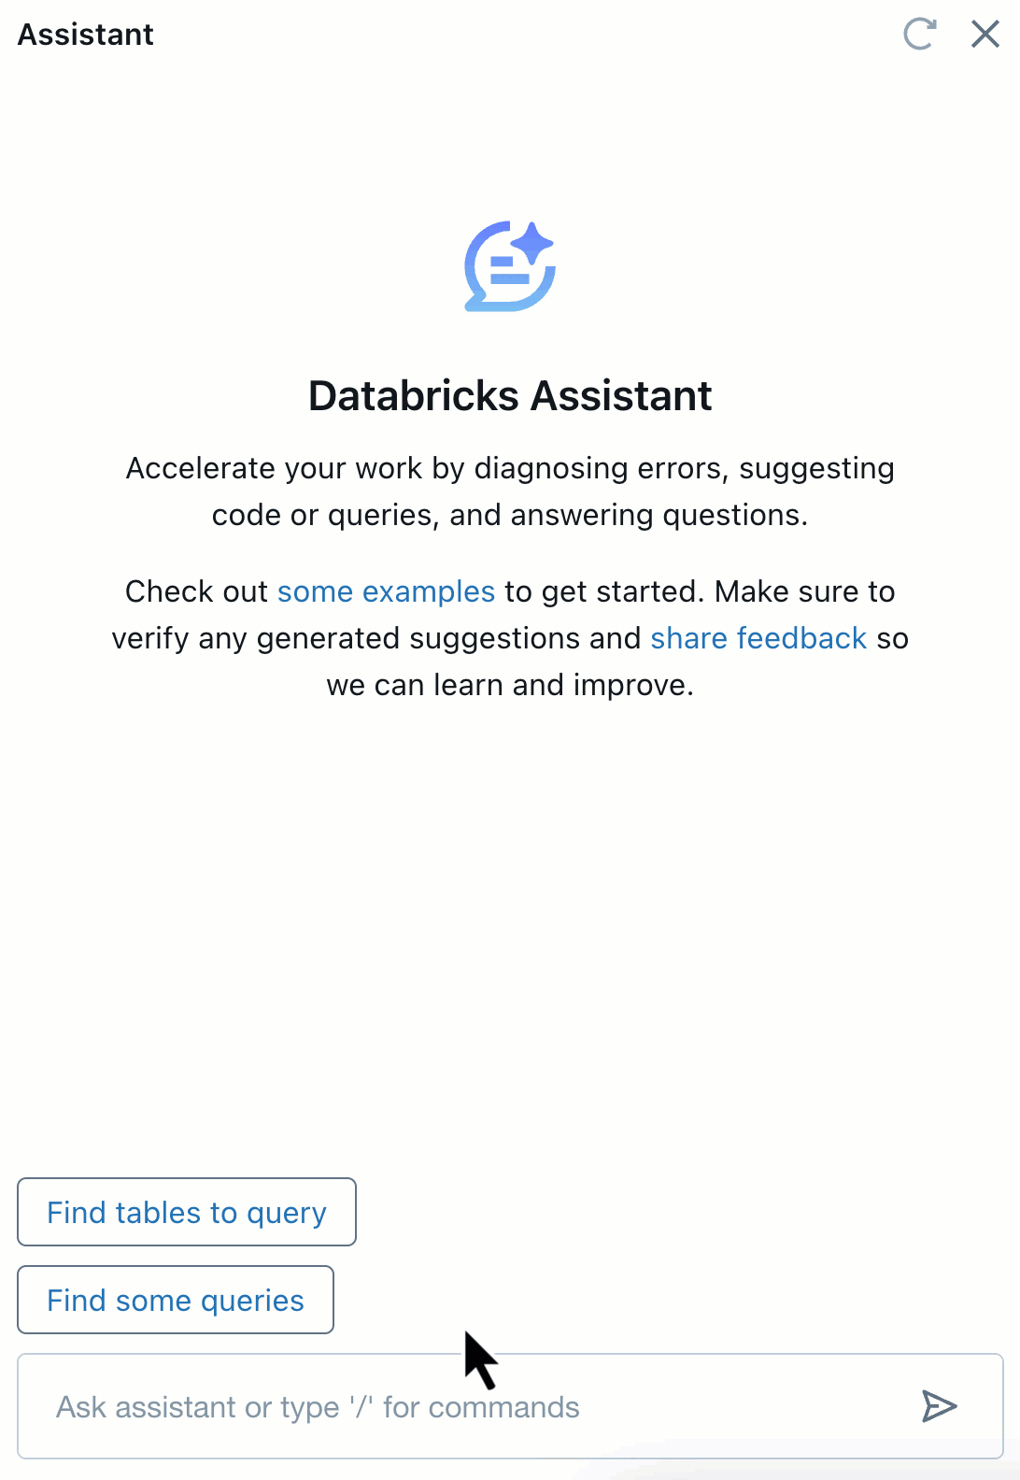
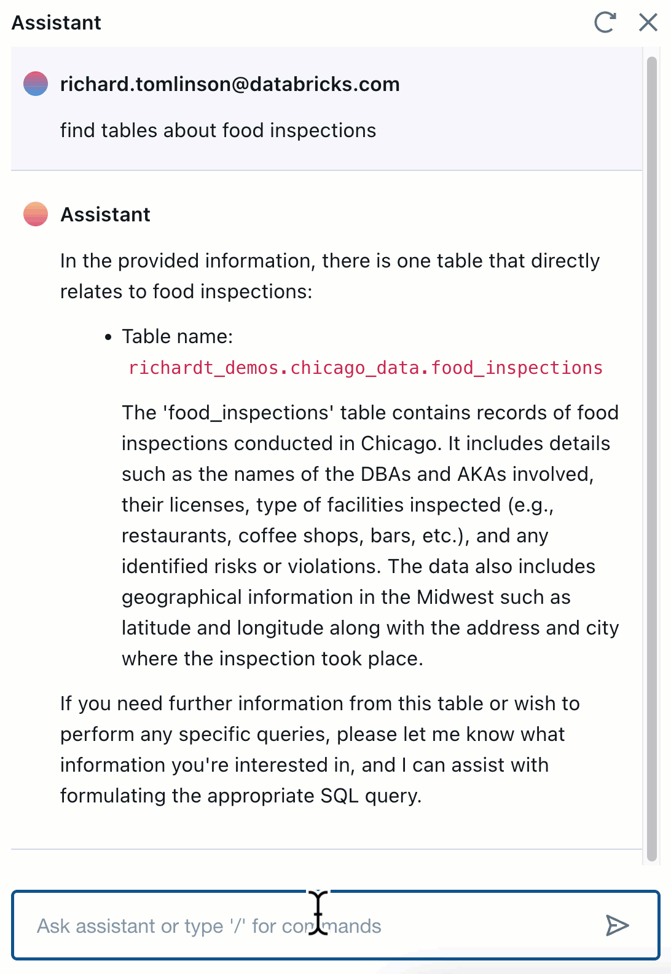
Example of a context-aware AI assistant
AI knows where to find the right data and only displays the tables I am allowed to see
AI knows how to create the right SQL relevant to the business question asked

Slide 10

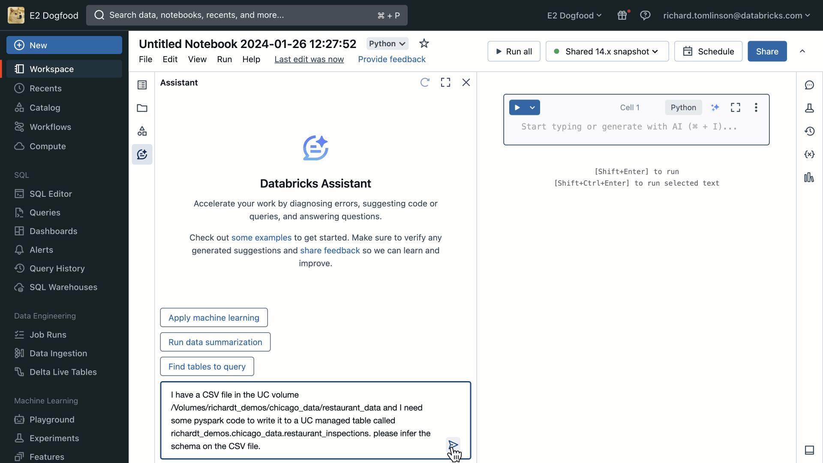

Databricks Assistant
Boost productivity with your context-aware AI assistant
Generate, explain, and fix code with natural language
AI assistance in every user experience
Powered by DatabricksIQ for highly relevant answers
🚀 Over 100K users assisted every month! 🚀
Notes:
First, we are thrilled to announce that Databricks Assistant will shortly become generally available, and since we launched Databricks Assistant last year we’ve seen amazing levels of adoption. Just last month alone we noticed over 100 thousand unique users are relying on the assistant to help them generate, explain, and fix python and SQL code with natural language.
We need your help to keep this momentum going.

Slide 11
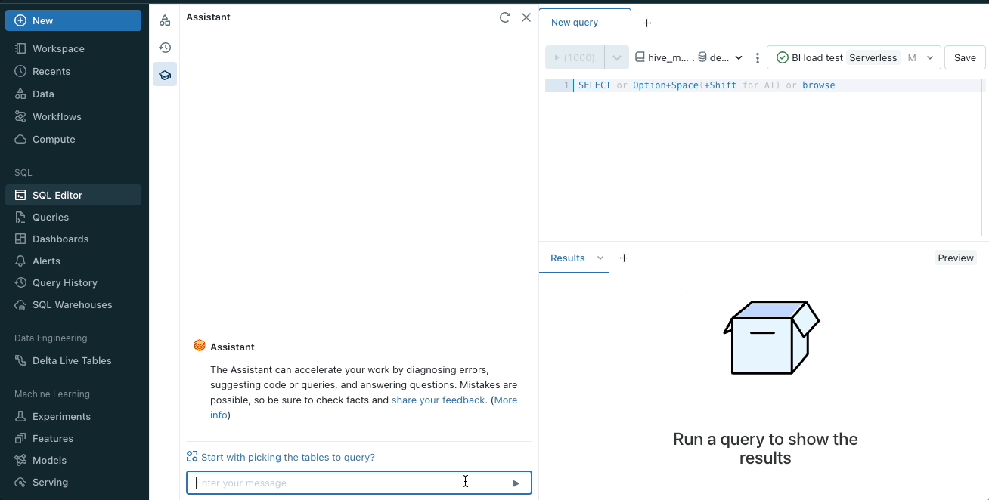
Generate, explain, and fix code with natural language
Takes requests in natural language and creates code snippets
Applies details from code cells, libraries, runtime, and more to improve accuracy
Explains, diagnoses, and fixes issues from within a cell

Slide 12
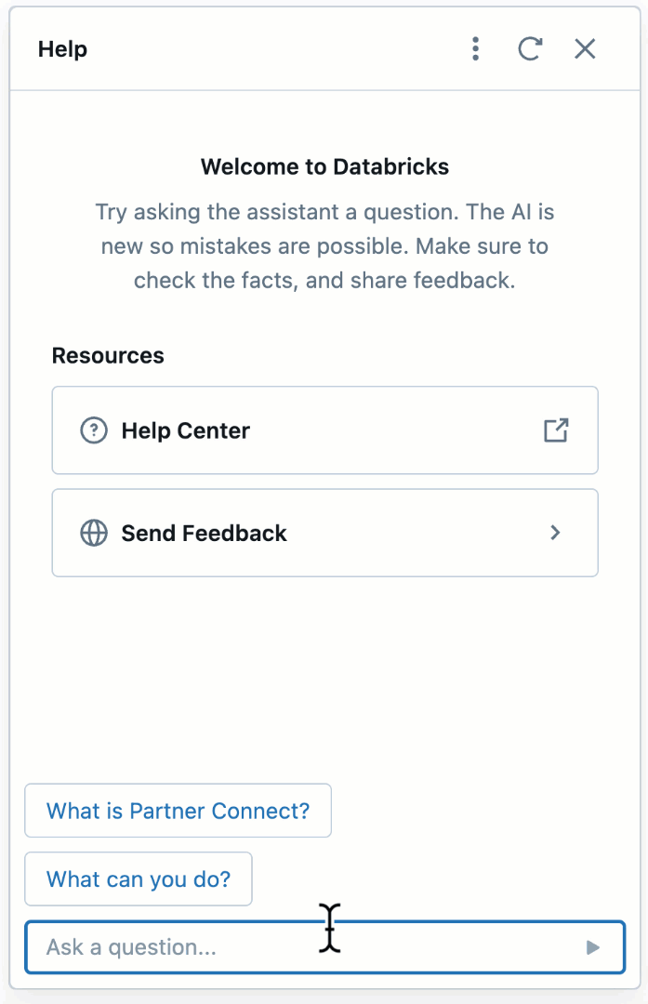
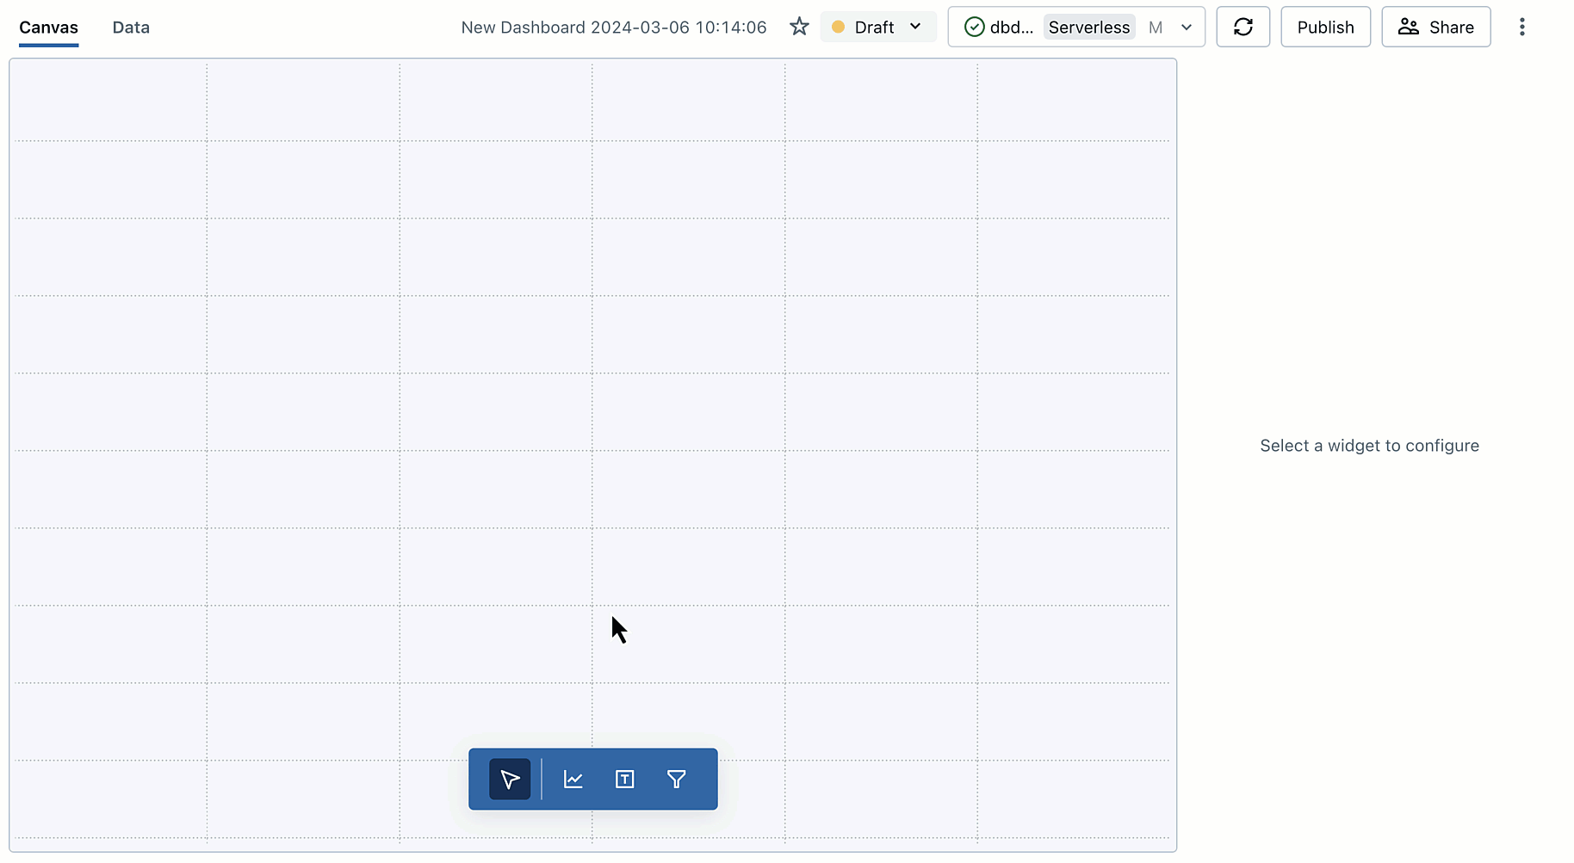
AI assistance in every user experience
Databricks Assistant in Notebooks
Databricks Assistant in Help
Databricks Assistant in SQL editor
Databricks Assistant in Lakeview dashboards
Boosts productivity for all users
Data Scientists | Data Engineers | SQL Analysts | Business Users
Notes:
Currently the Assistant can be found in a number of product surfaces in Databricks including Developer Surfaces like Notebooks, SQL Editor and Help. The Assistant also powers the text-to-visual capabilities in Lakeview Dashboards. This is still early in its development but this capability will help take Databricks to a much wider audience including BI consumers and business teams.
The vision for DB Assistant is to provide one assistant for ALL product surfaces; today it’s very authoring centric experience but in the future we want to expand capabilities to help on any task, in any product surface in Databricks, and Wes will cover this more in the roadmap session.

Slide 13
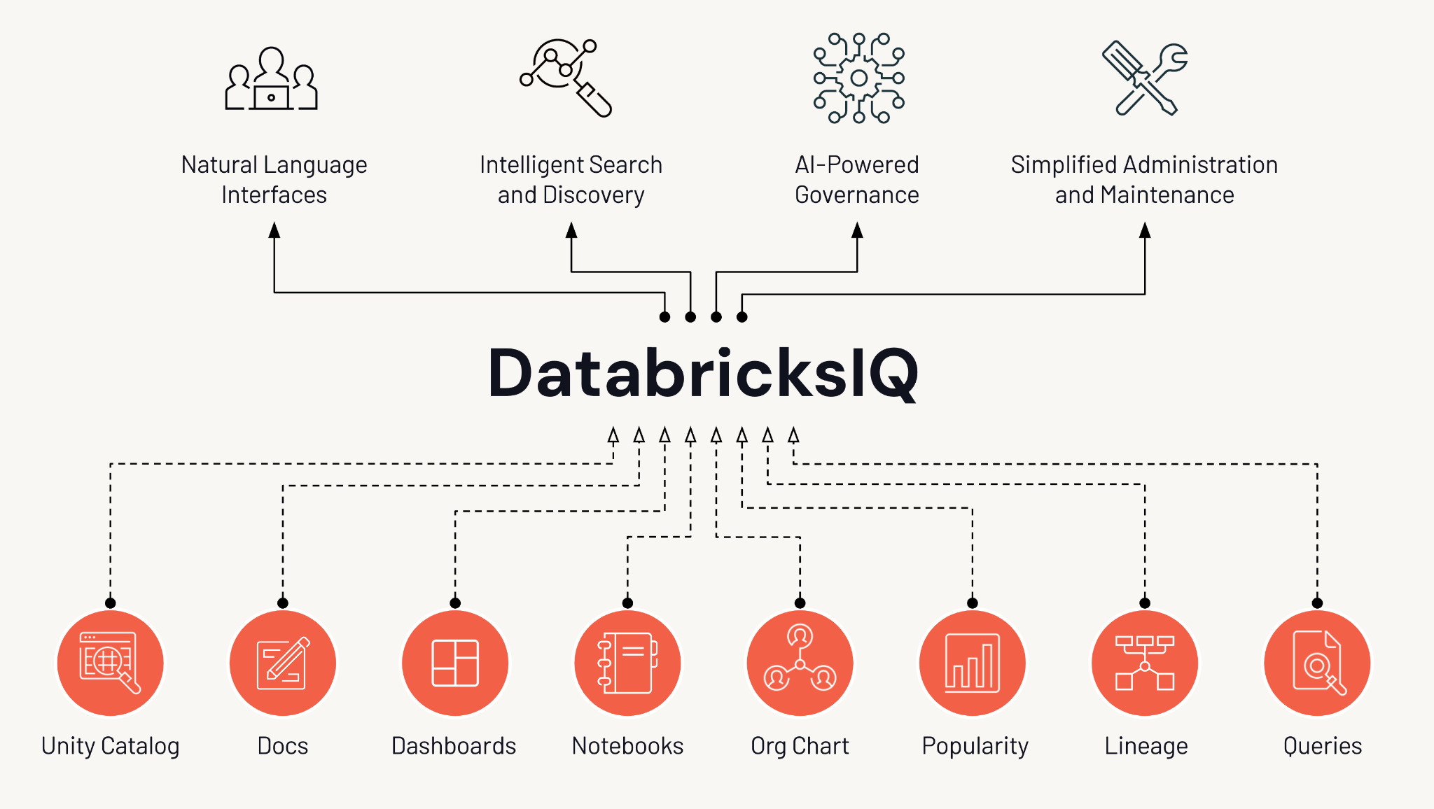
Powered by DatabricksIQ
The data intelligence engine that understands your business
Apply AI to your data to provide relevant, accurate, and secure answers
Enables natural language interfaces for everyone
Uses predictive models to automatically optimize your data platform
Notes:
One of the key differentiators for Databricks Assistant is that it is powered by DatabricksIQ, the data intelligence engine for the Databricks platform.
DatabricksIQ is an AI system that uses a variety of techniques and different models to add contextual awareness and to the Assistant and other user surfaces. For example, the assistant is aware of your tables and columns because it leverages the knowledge graph built for our in-product search - which also uses AI-generated comments. The assistant also uses its own private model to power features such as Ghost text - which Wes will cover later in the presentation.
DatabricksIQ is still evolving, but to understand more about what's under the hood please check out the deck and presentation by Ritendra Datta from the recent R&D Kickoff.

Slide 14
What can you do
with Databricks Assistant?

Slide 15
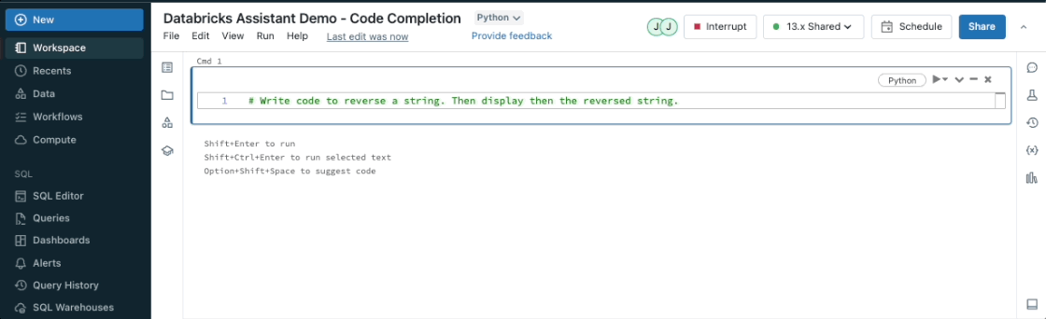
Autocomplete code or queries
Generate code from comments inside a notebook cell or SQL editor

Slide 16
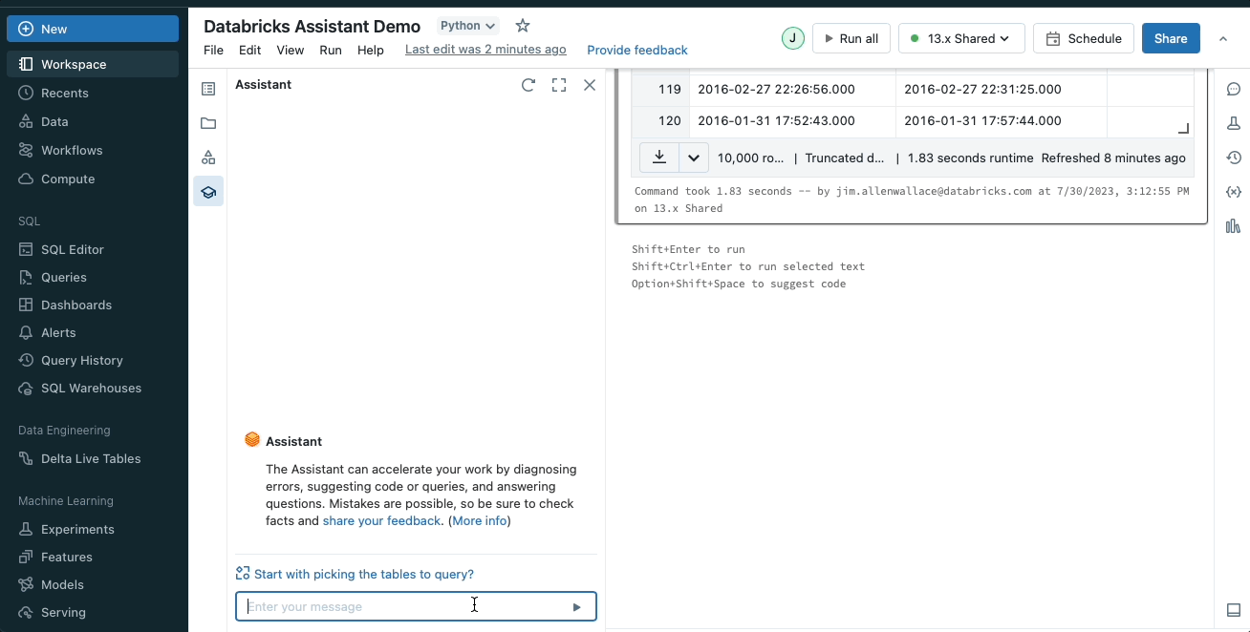
Transform code
Always use the best language for the current task
Utilize alternative frameworks seamlessly

Slide 17
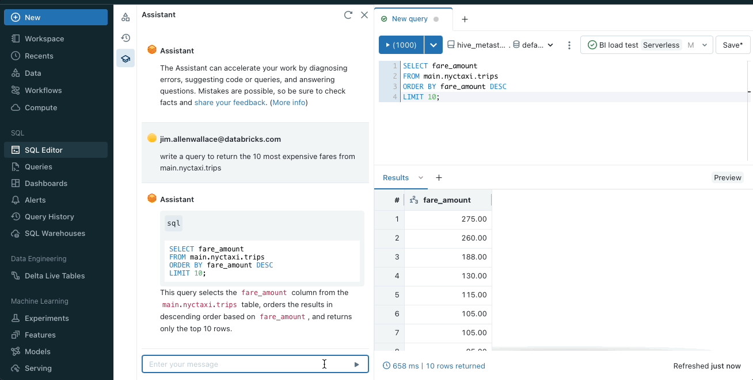
Explain code or query
Get a description of code in clear, concise language
See what data and tables are being used without needing to leave the editor

Slide 18
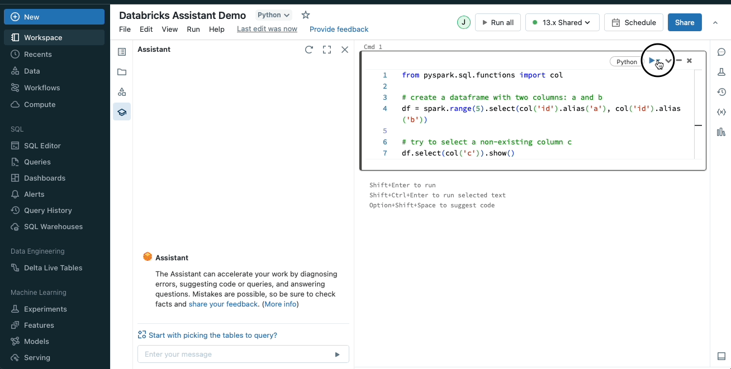
Fix issues fast
Identify errors and see an explanations
Receive recommended fixes
Update code with suggested snippets to resolve the issue

Slide 19
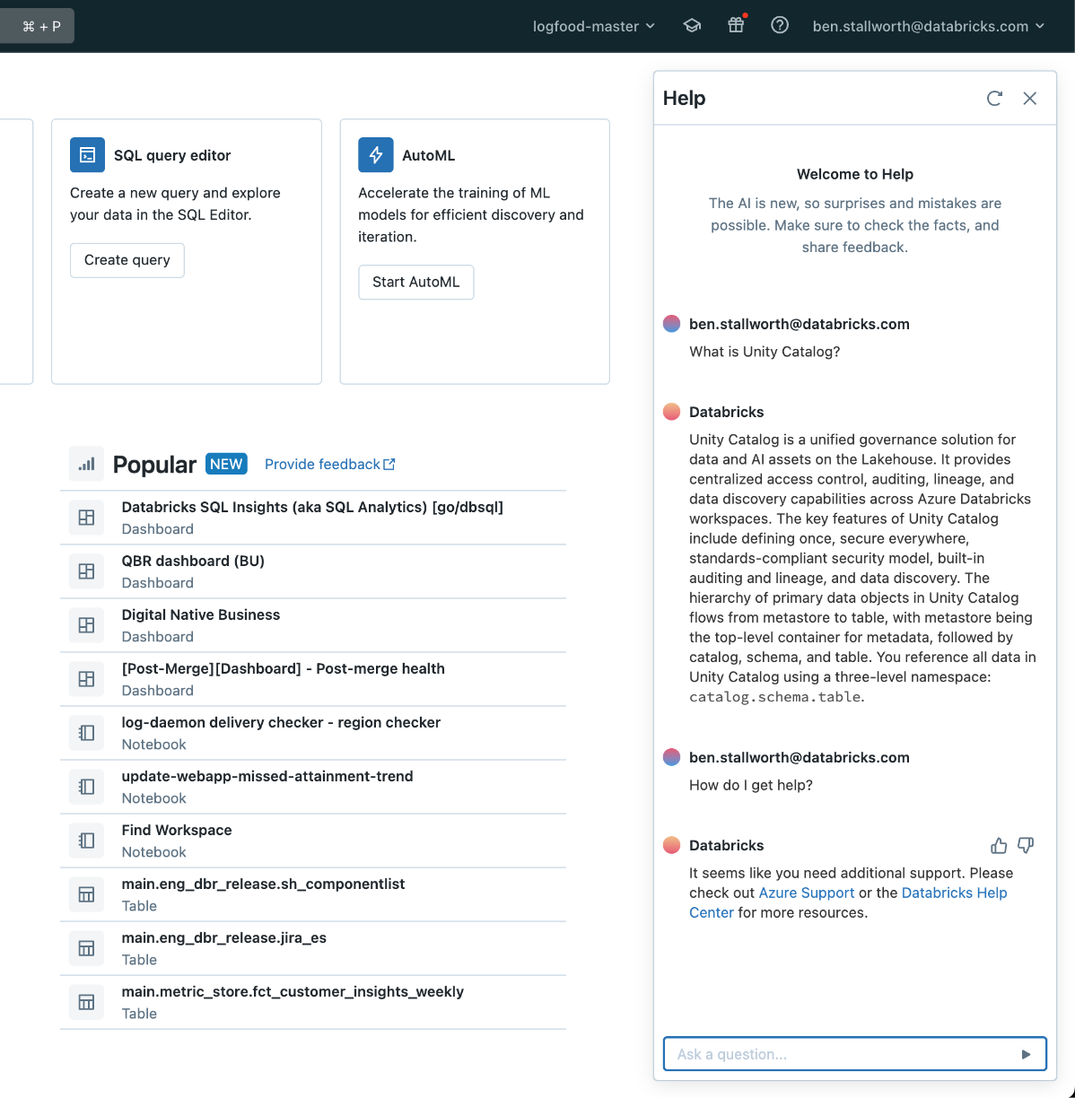
Get help and support
A conversational interface for product documentation and support
Get accurate answers for Databricks technologies like Spark, Delta Live Tables, DBSQL, and more.
Improved flow for creating support tickets

Slide 20
AI Assistant Best Practices
Use the Find Tables action for better responses: Databricks Assistant uses many different signals to provide more accurate and relevant results. Some of the context that Databricks Assistant currently uses includes code or queries in a notebook cell or Databricks SQL editor tab, table and column names, and active tables. You can specify the tables you want Databricks Assistant to use as context when generating the response.
Test code snippets by directly executing them in the Assistant panel: In the Databricks Assistant chat window, you can directly edit previous prompts and re-submit the request without losing any existing context. By running the code directly in the Assistant panel, you can test and quickly iterate on the code before copying it over to your notebook.
Review any code that is generated by Databricks Assistant before executing it: Databricks Assistant, like any generative AI tool, can and will make mistakes. If you get responses that don't look right, or are syntactically incorrect, use the thumbs-down icon to send feedback. Databricks Assistant is constantly learning and improving to return better results.
Use the Assistant’s chat history to iteratively clean, explore, filter, and slice DataFrames in the Assistant pane: You can also edit the code that Databricks Assistant generates directly in the Assistant chat box before moving the code to the notebook.

Slide 21
Using Databricks from IDEs

Slide 22





Apache Spark 3.4: Spark Connect
Spark Connect thin Client API based on DataFrame API
Applications
Spark’s Driver
Modern data application
Multi-tenant Application Gateway
Analyzer
IDEs / Notebooks
Spark Connect Client API
Optimizer
Scheduler
Programming Languages / SDKs
Distributed Execution Engine
Notes:
With Apache Spark 3.4, we GAed Spark Connect to address all these problems.
So what is Spark Connect? The idea is very simple: decouple the architecture and introduce a common client API connects to the driver to decouple the architecture.
This client API is designed to be very thin, so it can be embedded everywhere, from application servers, IDEs, notebooks, and all programmming languages.
From this aspect, it is very similar to JDBC/ODBC and various SQL drivers. But it does a lot more than SQL, because you can get the full power of Spark with the DataFrame API.

Slide 23
Client
DataFrame API
spark.read.table(“logs”)
.select(“id”, extract_profile(“blob”).write.insertInto(“profiles”)
Translated into logical
parse plan
InsertInto `profiles`
+- Project
+- UnresolvedTable `logs`
Unresolved logical plan is sent to the server via gRPC/protobuf (language agnostic)
Results streamed back to the client via gRPC/Arrow (language agnostic)
Spark Server
Analyzer
Optimizer
Scheduler
Distributed
Execution Engine
Notes:
Let's take a look at how this works in practice.
We are creating a protocol between the thin client and the servers. All the client library needs to do is to generate these unresolved query plans based on proto and send them to the server using gRPC. Note that this protocol between client and server is language agnostic, and the clients don't need to be fat.
These query plans are then handled by the Spark servers, going through all the standard process of optimization and execution, and then send back to the client using gRPC again.
This unresolved query plan protocol can be very simple and stable. And we can create different programming language client implementations based on this protocol.
Of course, out of the box, we want to provide the Python implementation that's 100% compatible with the existing PySpark API, so you don't even need to rewrite your applications to leverage this protocol.

Slide 24
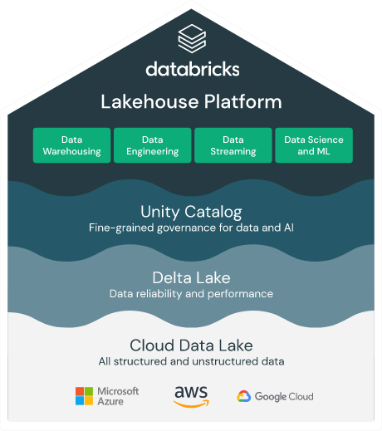




Connect to Databricks from anywhere!
Databricks Connect “v2” powered by Spark Connect
IDEs / Notebooks
Data Applications
Databricks Connect
Your application
Databricks Connect
Partner Integrations
Notes:
Databricks Connect v2 builds upon and uses Spark Connect as the protocol for communication between the client and the server, bringing remote connectivity to the Databricks Lakehouse!

Slide 25
Develop and debug from your IDE of choice
Interactive debugging based on Spark Connect’s remote connectivity
Spark Connect plus Databricks specific functionality such as DBUtils authentication etc.
Fully integrated with Unity-Catalog governed lakehouse: fine-grained access control, data lineage etc.
From any IDE, complements Databricks VS Code Extension
Installation and upgrades:
Easy to set up: pip install databricks-connect>=13.0
No code adaptation apart from a Connection String
Always released with new DBR versions (starting from DBR 13)
Seamless upgrade to new DBR versions due to decoupled client-server architecture (Spark Connect)
Notes:
Db Connect: develop workloads that run on databricks from your IDE
There are no code adaptations to be made: Users simply need to configure a connection string to their Databricks cluster and can then debug and run their existing Python and Scala code on their Databricks clusters.
The debugging experience is based on the built-in debugging capabilities of a users’ IDE of choice for plain Python/Scala. On top, Spark DataFrame variables from code running on Databricks cluster, can be inspected.
Spark Connect is part of PySpark, the scala client and R library, which we are builiding
We provide additional functionality on top, such as autheticatoion via PAT, and OAuth (will foloo)
Connect to UC clusters
All the other Databricks featurs
Applications built on Spark
Develop applications that integrate with Spark using Python/Scala, or also other languages by implementing the Spark Connect dataframe API (go/rust)
Adobe customer notes: https://docs.google.com/document/d/10IDSO5YOywkdUCdfUwahFZB2v-JBpGl277jASSDX4V0/edit#heading=h.kstfg3t4x1de

Slide 26
Getting Started

Slide 27
Getting Started
Install DB Connect and configure your Spark session
Install Python package, pip install databricks-connect>=13.2
Create a config profile (workspace & cluster ID, auth token)
Create your Spark session using a config profile
Develop, debug and run your applications!
[DEV]
host = https://<your_workspace>.databricks.com
cluster_id = <your_cluster_id>
token = <your_token>
from databricks.connect import DatabricksSession
spark = DatabricksSession.builder.profile("DEV").getOrCreate()
Notes:
Install DB Connect: essentially PySpark and a couple of Databricks specific packages
Create config

Slide 28
Simple Example
Backwards compatible
# from databricks.connect.session import DatabricksSession as SparkSession
from pyspark.sql import SparkSession
spark = SparkSession.builder.getOrCreate()
df = (spark.read.table("samples.nyctaxi.trips")
.filter("trip_distance < 10"))
df = (df.select(
df["pickup_zip"].cast("string"),
df["dropoff_zip"].cast("string"),
df["trip_distance"],
display(df.toPandas())
Notes:
Environment variable needs to be set with connection string

Slide 29
DB Connect Best Practices
Use your IDE of choice: Databricks Connect v2 allows developers to use their preferred Integrated Development Environments (IDEs) to interactively develop and debug their code in any Databricks workspace. This ensures that code is developed more efficiently and with higher quality.
Embed Databricks Connect library into your applications: Users can simply embed the Databricks Connect library into their applications and connect to their Databricks Lakehouse. This unlocks several new capabilities and use cases for data practitioners.
Installation and Configuration: To get started with Databricks Connect, you need to install the Databricks Connect client library and configure the connection string to your Databricks cluster. You can do this by running the command 'pip install databricks-connect>=13.0' in your IDE.
Use Spark Connect: Databricks Connect v2 is built on open-source Spark Connect, which introduces a decoupled client-server architecture for Apache Spark. This allows remote connectivity to Spark clusters using the DataFrame API and unresolved logical plans as the protocol.
Develop and Debug from your IDE: Databricks Connect lets developers interactively develop and debug their code on Databricks clusters using the IDE's native running and debugging functionality.

Slide 30
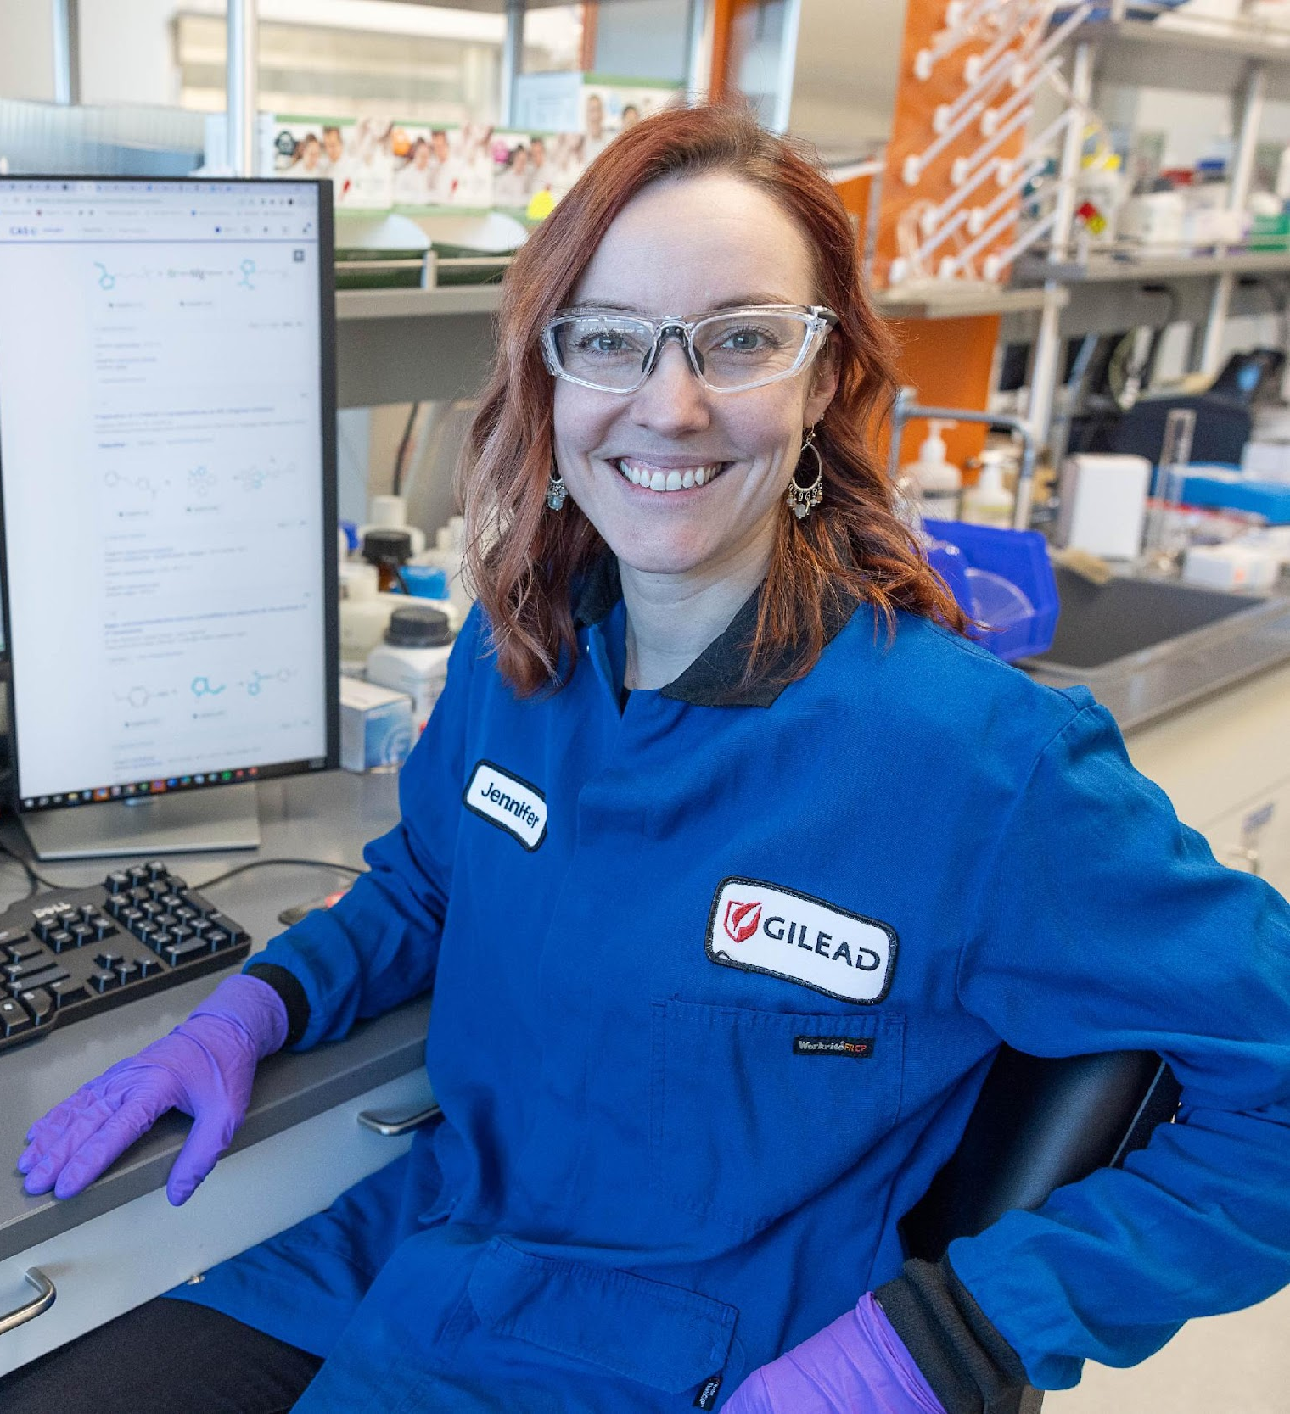
Delta Table

Slide 31



Data reliability challenges with data lakes
Failed production jobs leave data in corrupt state requiring tedious recovery
✗
Lack of schema enforcement creates inconsistent and low quality data
Lack of consistency makes it almost impossible to mix appends and reads, batch and streaming
Notes:
Let's step back to look at the challenges of Data lakes.
For Data Engineering workloads, the problems of Data Lakes are reliability, performance, governance, and data quality
With Reliability, it’s hard to apply inserts, updates and deletes on big data. Jobs can fail halfway and no simple way to keep historical versions of the data.
With Performance, there can be too many small files resulting in a “small file problem” and there is the difficulty of managing large metadata. Both of which would result in poor performance.
With governance, there is no simple security measures to enforce security policies
With Quality, no validation in place to maintain data quality

Slide 32


Performance challenges with data lakes
Too many small or very big files - more time opening & closing files rather than reading contents (worse with streaming).
Partitioning aka “poor man’s indexing”- breaks down if you picked the wrong fields or when data has many dimensions, high cardinality columns.
No caching - cloud storage throughput is low (cloud object storage is 20-50MB/s/core vs 300MB/s/core for local SSDs).
Notes:
Too many small files: jobs spent most of the time opening and closing files, rather than reading the contents of the files.
Caching: Cloud storage throughput is low (S3 is 20 to 50MB/s/core, vs 300MB/s/core for local NVMe SSDs)
Indexing:
People have been using partiitoning as poor man’s indexing for a long time
partiioning breaks down:
multiple dimensions
high cardinality columns (date is fine, but user id or ip address is not)
floating point values (decimal, floating point, e.g. “cost”, “price”, “revenue”)

Slide 33


Open-Source storage format enabling the Lakehouse architecture
RELIABILITY
PERFORMANCE
Open source
ACID compliant
Schema enforcement
Unified batch and streaming as a source or sink
Time travel/data snapshots
Update, merge, and delete datasets easily
Independent compute and storage scaling
Indexing
Automatic optimization and compaction
Data skipping
Caching
Auto-data loader, data expectations, and more to come!

Slide 34





Databricks Lakehouse Platform
Lakehouse Platform
Data
Warehousing
Data Engineering
Data Streaming
Data Science
and ML
Simple
Unify your data warehousing and AI
use cases on a single platform
Unity Catalog Fine-grained governance for data and AI
Open
Built on open source and open standards
Delta Lake
Data reliability and performance
Cloud Data Lake
All structured and unstructured data
Multi-cloud
One consistent data platform across clouds
Notes:
You’re able to have all of your data, structured and unstructured, in one place
We then bring reliability and extremely fast query performance to that data without leaving the lake with an open technology called Delta Lake
So that you can use it for data warehousing workloads
Next, Unity Catalog provides governance for all of the data with one consistent model
And then we offer purpose-built tools to allow everyone to collaborate on the same data
The advantages of this are…
First, you’ve dramatically simplified your data architecture for all of your workloads
Data warehousing, data science and ML, as well as data engineering and data streaming
Second, the entire platform is built on open source and open standards
This means you have a lot of freedom in how you evolve your data strategy
Without walled gardens restricting present and future choices
Not to mention the vast community of talent that resides in the open source community
Finally, you get one consistent experience across all clouds
You don’t need to invest in reinventing the wheel for every cloud platform that you’re using to support your data and AI efforts
TRANSITION: But, of course, one company can’t do everything…

Slide 35
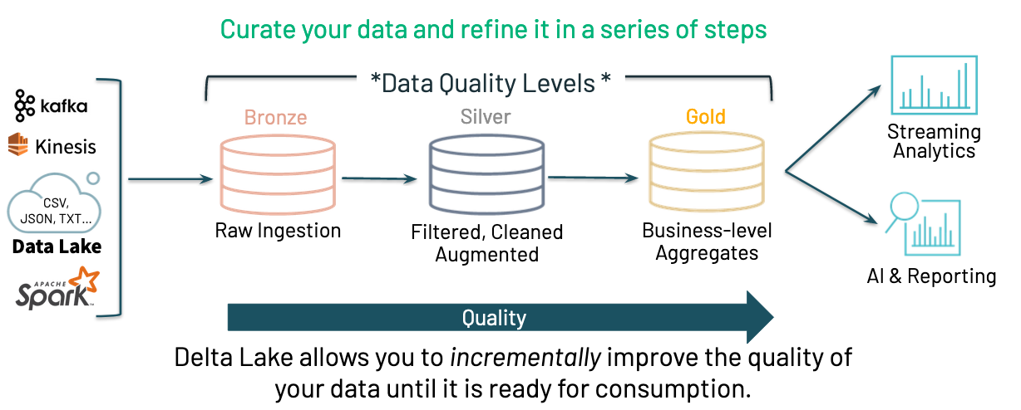

Slide 36
Get Started with Delta - Spark APIs and SQL
Instead of parquet...
… simply say delta (default format DBR 8.x)
CREATE TABLE ...
USING parquet
...
dataframe
.write
.format("parquet")
.save("/data")
CREATE TABLE ...
USING delta
…
dataframe
.write
.format("delta")
.save("/data")

Slide 37
Convert to Delta Tables
CONVERT TO DELTA parquet.`path/to/table` [NO STATISTICS] [PARTITIONED BY (col_name1 col_type1, col_name2 col_type2, ...)]
CONVERT TO DELTA iceberg.`s3://my-bucket/path/to/table`; -- uses Iceberg manifest for metadata
[CREATE OR] REPLACE TABLE table_name
[SHALLOW | DEEP] CLONE source_table_name [TBLPROPERTIES clause] [LOCATION path]
Then do:
OPTIMIZE events WHERE date >= current_timestamp() - INTERVAL 1 day ZORDER BY (eventType)
Notes:
https://docs.databricks.com/sql/language-manual/delta-convert-to-delta.html

Slide 38
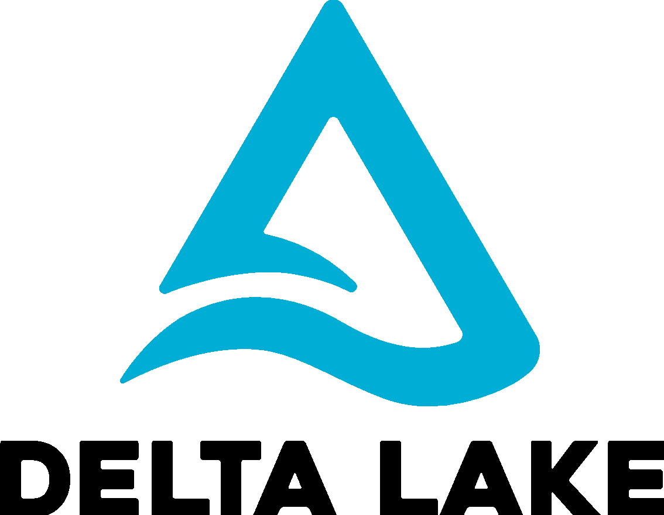
Deep Dive...
How does
work?
Notes:
Let’s move from ideas to details…

Slide 39
Delta on Disk
my_table/
_delta_log/
00000.json
00001.json
date=2019-01-01/
file-1.parquet
Transaction Log
Table Versions
(Optional) Partition Directories
Data Files
Notes:
Under the covers, Delta Lake uses parquet files. If you are familiar with parquet, the bottom of this diagram (with the blue labels) will look very familiar. This is standard parquet format, where partition directories each hold 1 to many physical parquet files.
What Delta adds is at the top of the diagram (with the green labels). Delta adds the delta_log, where it keeps track of all the commits.

Slide 40
Version N = Version N-1 + Actions
Change Metadata – table name, schema, partitioning, etc
Add File – adds a file (with optional statistics)
Remove File – removes a file
Result: Current Metadata, List of Files
Notes:
Within each commit, there are three possible pieces of information:
Change Metadata if you change the schema, partition structure, or table name
Add File
Remove File
This is how Delta manages the table.

Slide 41
Implementing Atomicity
Commits
Add 1.parquet
Add 2.parquet
Changes to the table are stored as ordered, atomic units called commits
000000.json
000001.json
…
Remove 1.parquet
Remove 2.parquet
Add 3.parquet
No need to do file listing on cloud storages
Notes:
In this example, we first wrote two files to the table, so in the first commit we see an add for 2 files.
The second commit shows a compaction. We are compacting two files into file 3, and removing the original 2 files.
The transaction log captures the flow of all transactions. This is beneficial for cloud-provider object storage, because these cloud storages has a huge performance penalty for listing files. Therefore, we are always giving the object store a specific list of files, rather than asking for a list of contents and iterating over it. The reader never has to do discovery of files.

Slide 42
Solving conflicts optimistically
Record start version
Record reads/writes
Attempt commit
If someone else wins, check if anything you read has changed
Try again.
Read: Schema
Read: Schema
Write: Append
Write: Append
User 1
000000.json
000001.json
000002.json
User 2
v0 is not the current. Checks for conflict in v1 and if not, commits v2
commits first
Notes:
A writer comes in and looks at which version of the table is current… in this example, both writers found version 0 as the current version.
<CLICK> User 1/job 1 finishes first and puts out version 1.
<CLICK> When write job 2 subsequently finishes, it sees that version 0 is no longer the current version. Therefore, it checks version 1 to see if there are any conflicts.
<CLICK> If there are none, the write proceeds and version 2 is created. If there is a conflict, the second write is re-tried.
This is a general-purpose solution, but it’s great for multiple streaming jobs, which are typically append-only. A batch job could also run at the same time, and all concurrency issues will be handled successfully.

Slide 43
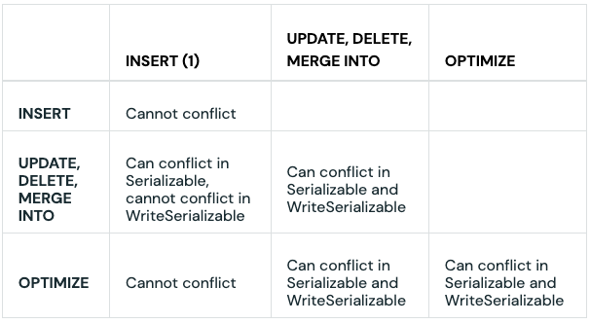
Concurrency - Write Conflicts
Inserts/Appends can conflict with Optimize if mergeSchema is true or autoOptimize is turned on
Avoid conflicts using partitioning and disjoint command conditions
// Target 'deltaTable' is partitioned by date and country
deltaTable.as("t").merge(
source.as("s"),
"s.user_id = t.user_id AND s.date = t.date AND s.country = t.country")
.whenMatched().updateAll()
.whenNotMatched().insertAll()
.execute()

Slide 44



Handling massive metadata
Large tables can have millions of files in them! How do we scale the metadata? Use Spark for scaling!
Add 1.parquet
Add 2.parquet
Checkpoint
Remove 1.parquet
Remove 2.parquet
Add 3.parquet
Notes:
At this point you might be thinking that we will end up parsing millions of json files to find out the state of a table. However, this is not the case because we periodically checkpoint the table and write all of its META data to a checkpoint file (every 10 commits by default use delta.checkpointInterval to change), which is in parquet format. This way we have an efficient columnar store of a table’s metadata, and we can use the power of Spark to manage the metadata, just as we do with the data itself.

Slide 45
Schema: Enforce & Evolve
Parquet supports schema evolution, but will allow you to “evolve” it into an incompatible schema, breaking your table
Delta enforces your schema by default, requiring an explicit config option to evolve it
Delta prevents you from evolving it incompatibly and ensures your table always works
Blog

Slide 46
Time Traveling
By Version
SELECT * FROM my_table VERSION AS OF 1071;
SELECT * FROM my_table@v1071 -- no backticks to specify @
spark.read.option("versionAsOf", 1071).load("/some/path")
spark.read.load("/some/path@v1071")
By Timestamp
SELECT * FROM my_table TIMESTAMP AS OF '1492-10-28';
SELECT * FROM my_table@14921028000000000 -- yyyyMMddHHmmssSSS
spark.read.option("timestampAsOf", "1492-10-28").load("/some/path")
spark.read.load("/some/path@14921028000000000")
Notes:
Now that we have these versioned commits, we can easily do time travel to any version of the data we want.
We can time travel by version…

Slide 47
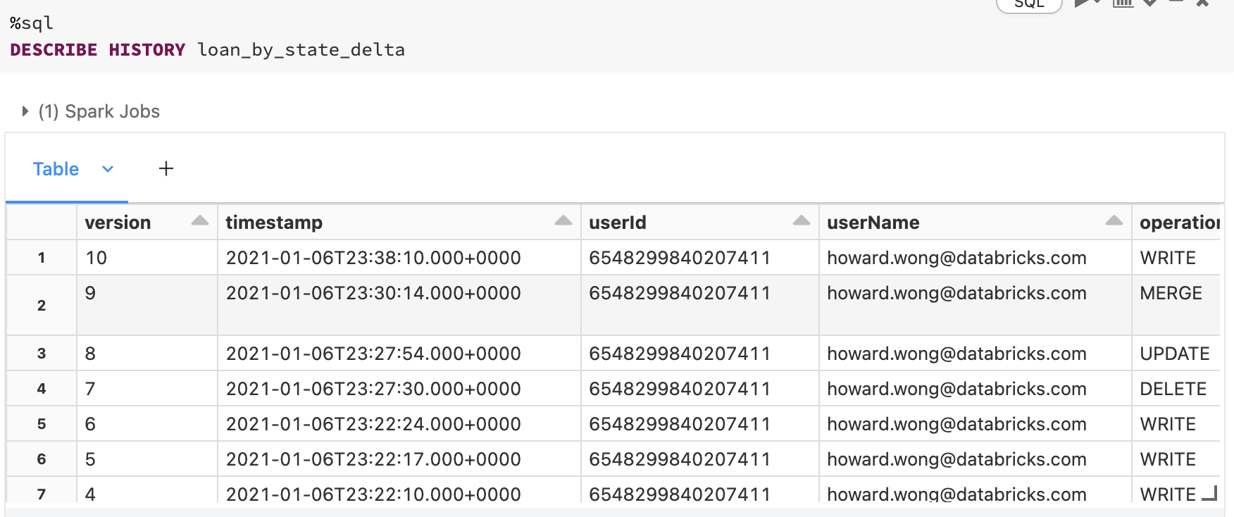
Describe History

Slide 48
Data Skipping
Simple, well-known I/O pruning technique
used by many DBMSes and Big Data systems
a.k.a. Small Materialized Aggregates, ZoneMaps, ColumnStore Index
Idea:
Track file-level stats like min & max
Leverage them to avoid scanning irrelevant files
Example:
SELECT * FROM table WHERE col < 5 SELECT file_name FROM index WHERE col_min < 5
file_name | col_min | col_max
file1.csv | 6 | 8
file2.csv | 3 | 10
file3.csv | 1 | 4
Notes:
Next we’ll discuss a number of innovations that make Delta Lake extremely performant. The first of these is Data Skipping, which is unique to Datbricks’ version of Delta Lake.
The slide is largely self-explanatory… in addition to tracking individual files in a table, we are also tracking statistics about the CONTENTS of those files. One of the things we track is the highest and lowest data value for each column in each file of a table. Parquet already tracks these values, but in the footer of the file itself. Since you have to open the file to read the statistics, you aren’t really saving much. Delta Lake centralizes these statistics into the query log, which greatly enhances query planning… we can now completely skip physical files where our filter values are below the minimum or above the maximum for each file. This potentially provides a great reduction in the total number of files we need to actually open and read.
NOTE that data skipping is CURRENTLY not available in open source. It could be open-sourced some time in the future.

Slide 49
MERGE (Upsert) Basics
MERGE INTO my_table d USING my_view s ON condition
WHEN MATCHED AND d.status = 'CLOSED' THEN DELETE
WHEN MATCHED THEN UPDATE SET d.status = 'CLOSED'
WHEN NOT MATCHED THEN INSERT *
Leverage data skipping (partition + stats) and figure out which files may match predicate
Collect input_file_name for all rows that match condition. Ensure 1-1 mapping
Rewrite files found above by updating the rows that match the conditions
Notes:
Upserts (batches of data with a mix of appends and updates) also benefit from data skipping. Slide contents are self-explanatory.

Slide 50
OPTIMIZE: Compaction Built-in
OPTIMIZE my_table
File Size Tuning
DBR 8.2+
delta.targetFileSize - easily set target file size
delta.tuneFileSizesForRewrites - detect if a table is receiving lots of MERGEs, then DBR will automatically switch to smaller file sizes to improve file pruning
DBR 8.4+: We’ll run these automatically
The target file size is based on the current size of the Delta table
Tables smaller than 2.56TB, the autotuned target file size is 256MB
Tables with a size between 2.56TB and 10TB, the target size will grow linearly from 256MB to 1GB
Tables larger than 10TB, the target file size is 1GB
Notes:
Delta Lake offers built-in file compaction. Call OPTIMIZE and small files will be compacted incrementally. By default, we compact to 1GB files, but this is tunable.

Slide 51
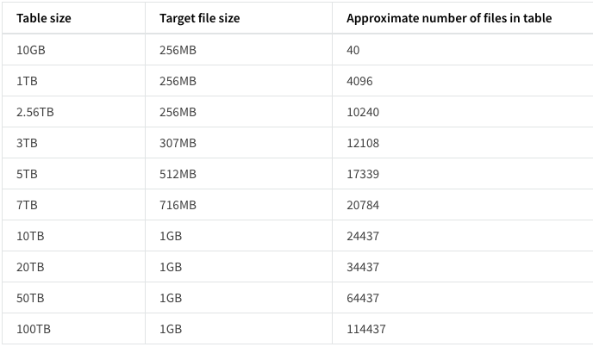
Automatic File Size Tuning

Slide 52
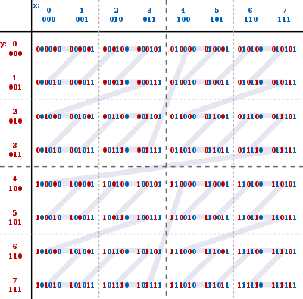
ZORDER: Multi-dimensional Clustering
OPTIMIZE my_table ZORDER BY (col1, col2)
Clusters data into Z-Cubes
Each box is a separate file
Effective on 3-5 columns
Notes:
https://docs.google.com/document/d/1VzsqKCkauv3udSbDj4YgGIRnleZO5XbD9UDORFI_KUA/edit#heading=h.dd2cc57oc5wk
Compaction by itself is nice, but it becomes even more interesting if we combine compaction with ways to organize the data to make it more useful and performant.
Z-ordering is a way to organize data to make reading it more efficient. Here is a 2-column example. We interleave the bits of the two columns, and then sort the results before writing to physical files. In this way, data values that are “close together” in meaning also become “close together” in the physical files. This can make queries much faster. Z-ordering works well with a few columns, and becomes less effective when you try to z-order on more than 4 or 5 columns.
Z-ordering works best on numeric/date types, but is also feasible on strings.
Z-ordering and partitioning work together. Z-ordering is a good choice when column cardinality is too high to use for a partition key.
We are currently experimenting with another approach called Hilberg curves, which may prove to be an even better solution.

Slide 53
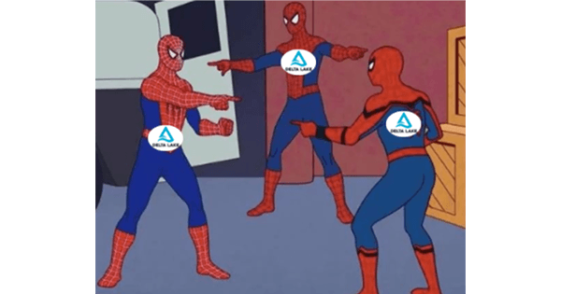
Delta Clones
Shallow or Deep clones
Clone a specific version (useful for Snapshots or ML)
Clone for backups
Stage changes to tables
Blog

Slide 54





What Delta Change Data Feed Does for You
Improve ETL pipelines
Process less data during ETL to increase efficiency of your pipelines
Unify batch and streaming
Common change format for batch and streaming updates, appends, and deletes
BI on your data lake
Incrementally update the data supporting your BI tool of choice
Meet regulatory needs
Full history available of changes made to the data, including deleted information
Delta Change Data Feed
Notes:
Key Points:
Delta Change Data Feed allows for less data to be replicated or touched when processing updates, dramatically reducing the time needed to make changes
Batch and streaming sources converge into the same format of change logs in Delta Change Data Feed for unified, efficient downstream processing
The cleansed and aggregated data used for BI, visualizations, and analytics is updated incrementally - giving analysts access to trusted, governed data as changes come in rather than having to wait for daily jobs
For even faster updates to BI tooling, use materialized views based upon Delta Change Data Feed
Audit and regulatory compliance often need to what changes have been made to data over time. Delta Change Data Feed provides traceability back through the history of individual records and values to ensure that historical updates are available.

Slide 55





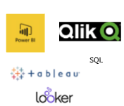

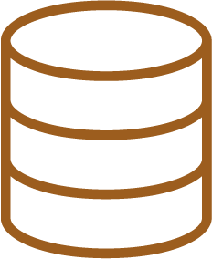
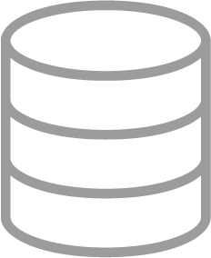


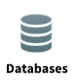
Where Delta Change Data Feed Applies
BRONZE
SILVER
GOLD
Raw Ingestion and History
Filtered, Cleaned, Augmented
Business-level Aggregates
External feeds, Other CDC output,
Extracts
CDF
Notes:
Delta Change Data Feed is an output from Delta Lake. This means that CDF applies when processing from a Delta format to a further step in the data flow.
In order to take advantage of the Delta Change Data Feed, simply bring in your external data sources to the Bronze layer, as previously done, and then enable CDF from that point forward.
This will allow you to use the Change Data Feed in moving to the Silver or Gold layers or feeding out to an external platform.

Slide 56
Change Data Feed:
Original Table (v1)
Change data
(Merged as v2)
Change Data Feed Output
PK | B | Change Type | Time | Version
A2 | B2 | Preimage | 12:00:00 | 2
A2 | Z2 | Postimage | 12:00:00 | 2
A3 | B3 | Delete | 12:00:00 | 2
A4 | B4 | Insert | 12:00:00 | 2
 | PK | B
 | A1 | B1
 | A2 | B2
 | A3 | B3
 | PK | B
 | A2 | Z2
 | A3 | B3
 | A4 | B4
A1 record did not receive an update or delete.
So it will not be output by CDF.
Notes:
We start with the original table, which has three records (A1 through A3) and two fields (PK and B)
(Click to build)
We then receive an updated version of this table that shows a change to field B in record A2, removal of record A3, and the addition of record A4
(Click to build)
As this gets processed, the Delta Change Data Feed captures only records for which there was a change. This is what allows Delta Change Data Feed to speed up ETL pipelines as less data is being touched.
Note that record A1 is not reflected in the Change Data Feed output as no changes were made to that record.
In the case of updates, the output contains what the record looked like prior to the change, called the preimage, and what it held after the change, called the postimage. This can be particularly helpful when producing aggregated facts or materialized views as appropriate updates could be made to individual records without having to reprocess all of the data underlying the table. This allows changes to be reflected more quickly in the data used for BI and visualization.
For deletes and inserts, the affected record is shown with an indication of whether it is being added or removed.
Additionally, the Delta version is noted so that logs are maintained of what happened to the data when. This allows greater granularity for regulatory and audit purposes as needed. We do capture the timestamp of these commits as well and will show this in a few minutes.
While this depicts a batch process, the source of updates could just as easily by a stream instead. The Change Data Feed output would be the same.

Slide 57
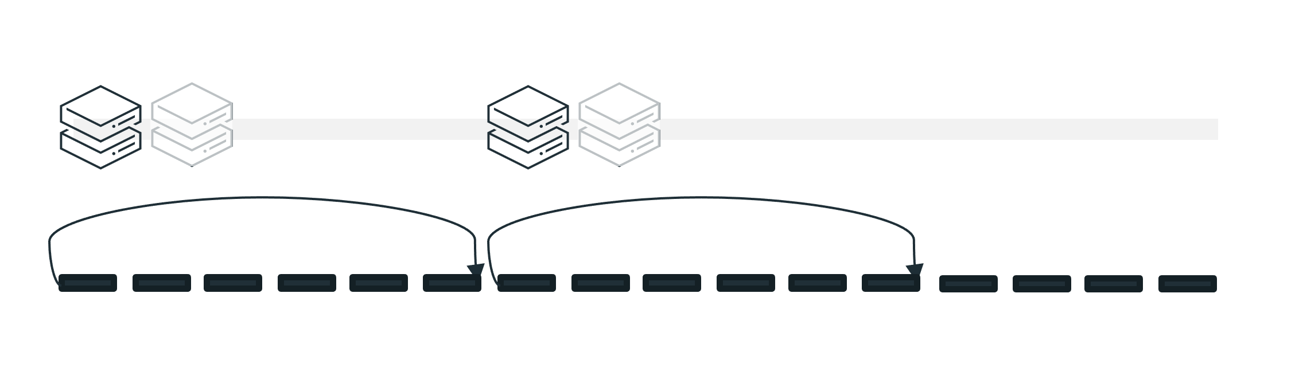
Consuming the Delta Change Data Feed
Stream-based Consumption
Delta Change Feed is processed as each source commit completes
Rapid source commits can result in multiple Delta versions being included in a single micro-batch
Stream - micro batches
12:00
12:08
12:10:10
A2 | B2 | Preimage | 12:00:00 | 2
A2 | Z2 | Postimage | 12:00:00 | 2
A3 | B3 | Delete | 12:00:00 | 2
A4 | B4 | Insert | 12:00:00 | 2
A5 | B5 | Insert | 12:08:00 | 3
A6 | B6 | Insert | 12:09:00 | 4
A6 | B6 | Preimage | 12:10:05 | 5
A6 | Z6 | Postimage | 12:10:05 | 5
12:00
A5 | B5 | Insert | 12:08:00 | 3
A6 | B6 | Insert | 12:09:00 | 4
A6 | B6 | Preimage | 12:10:05 | 5
A6 | Z6 | Postimage | 12:10:05 | 5
Batch Consumption
Batches are constructed based in time-bound windows which may contain multiple Delta versions
12:10:00
12:20
Batch - every 10 mins
Notes:
There are two ways to consume the Delta Change Data Feed in downstream processing - stream and batch.
Stream Mode
In stream mode, you use Delta structured streaming to process the Delta Change Feed as it comes in. This pattern allows for micro-batches to be consumed based upon the latest checkpoint without waiting for a predetermined time interval. The stream will simply process whatever has come in since the last checkpoint.
In the timeline shown here, let us assume that the large upsert from our previous example comes through at 12:00.
Our next insert (Delta version 3) commits at 12:08. The stream has already completed processing the first group and immediately picks up our 12:08 insert. It does not have to wait for a scheduled point in time to kick off.
We then receive the insert for Delta version 4 as 12:09. The stream process for the last commit has not yet completed.
Delta version 5, an update to the same record as was inserted in Delta version 4, comes in at 12:10:05. As soon as the prior stream micro-batch completes, the next kicks off and picks up Delta versions 4 and 5.
An important note here is that this does function as a micro-batch in that you now have both an insert and an update to a record in the same batch. You must add handling for choosing the latest data to insert from this batch.
Batch Mode
In batch mode, the processing of the Delta Change Feed is set to occur every X minutes. You must then add logic to handle identifying the current high water mark (the latest Delta version or timestamp previously processed) and picking up any changes from that point forward.
Following our example from before, let us assume that this batch process has been set to run every 10 minutes. When it kicks off at 12:00, it processes the large upsert.
There is a pause until 12:10, when the process kicks off again, establishes that the high water mark is Delta version 2, and picks up everything since then. In this case, it has both version 3 and version 4 to include.
The batch then pauses again and does not pick up version 5 until 12:20 despite it arriving shortly after the last batch was triggered.

Slide 58


When to Use Delta Change Data Feed
Delta changes include updates and/or deletes | Delta changes are append only
Small fraction of records updated in each batch | Most records in the table updated in each batch
Data received from external sources is in CDC format
 | Data received comprises destructive loads
Send data changes to downstream application | Find and ingest data outside of the Lakehouse
Notes:
While all of the benefits sound wonderful, it’s important to acknowledge that Delta Change Feed is not the best solution in every situation. Let’s walk through the best practices as to when to use, and when not to use, Delta Change Data Feed.
If your incoming data contains updates or deletes, Delta Change Data Feed is a good choice. This will help to reduce costly table scans to identify these types of changes downstream. On the other hand, if you only receive appends, Delta Change Feed may not be the best option. In this case, a better solution may be to use the checkpoint feature on structured streaming.
If you receive updates on a relatively small proportion of records in your table per batch, Delta Change Data Feed is a good choice. For example, if you have a table with 1 million records and you get updates to maybe 50,000 per batch, Delta Change Data Feed can help reduce processing overhead. However, if you receive updates to most of the records in the table every time you get a batch, this reduction will not be enough to merit using Change Data Feed unless it is for other purposes like audit trails.
If your incoming data is in a Change Data Capture format then maintaining this through Change Data Feed is a good option.
If you are intending to send changes as Change Data Capture types of output to downstream applications, Delta Change Data Feed is the best way to do so.
If the data you receive in a batch is a destructive load, meaning that it represents a complete overwrite of the underlying data and intends not to capture the changes made but rather to wipe out whatever was previously present, then Delta Change Data Feed should not be used. This would happen with a drop/create or truncate type of command to replace existing data.
As previously described, Delta Change Data Feed only applies from Delta sources. Therefore if you are looking to find and ingest data from outside of Delta Lake it will not work. We do have other features, such as Auto Loader, to help with bringing files in from your cloud storage. We also work with numerous partners that are able to extract data from external source platforms to then load into Delta.

Slide 59
Getting started with Delta Change Data Feed
Enable CDF on TABLE…
… or Establish CDF on CLUSTER
ALTER TABLE ...
SET TBLPROPERTIES (delta.enableChangeDataCapture = true);
spark.conf.set('spark.databricks.delta.properties.defaults.enableChangeDataCapture', True)
in SQL, Python, or Scala
in Python, or Scala
Notes:
https://databricks.com/discover/getting-started-with-delta-lake-tech-talks

Slide 60
Using Delta Change Data Feed
Query changes…
… and store them
SELECT … FROM table_changes('tableName',
startingVersion
[,endingVersion])
or
SELECT … FROM table_changes('tableName',
'startingTimestamp'
[,'endingTimestamp'])
INSERT INTO TABLE ...
USING delta ...
as
SELECT … FROM table_changes(...)
in SQL, Python, or Scala
Notes:
https://databricks.com/discover/getting-started-with-delta-lake-tech-talks

Slide 61
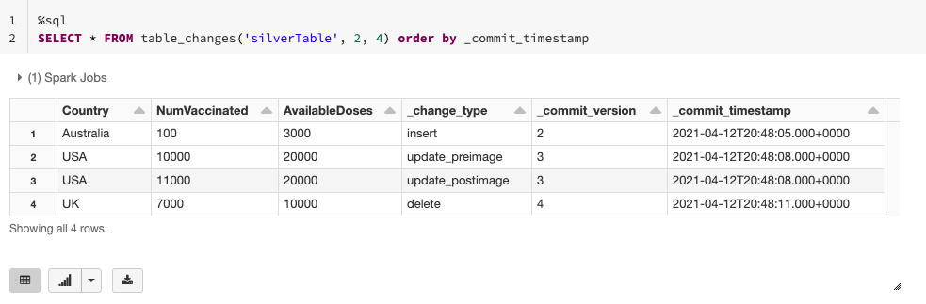
Getting started with Delta Change Data Feed
Notes:
https://databricks.com/discover/getting-started-with-delta-lake-tech-talks

Slide 62
Liquid Clustering

Slide 63


Challenges with determining partition strategy
I want to partition by timestamp, but it’s super high cardinality…
Which columns should I choose to partition by?
Team 1 filters on column A, but team 2 filters on column B…
I added this new column last month and now everyone filters by it…

Slide 64
Hive-style partitioning
Working example: A table partitioned by customer ID and date
 | 2023-02-05 | 2023-02-06 | 2023-02-07 | 2023-02-08
Customer A
Customer B
The Whale
Tiny 1
Tiny 2
Customer C
Target file size
Each partition contains files for one customer+date pair
e.g. (The Whale, 2023-02-07)
Number and size of files is different for each partition
Some partitions may not contain any files (yet)
Notes:
In order to understand why liquid will be such a big deal, first we need to understand what’s wrong with partitioning today.
Data skew

Slide 65
Hive-style partitioning
A table can be over- or under-partitioned — or both at the same time!
 | 2023-02-05 | 2023-02-06 | 2023-02-07 | 2023-02-08
Customer A
Customer B
The Whale
Tiny 1
Tiny 2
Customer C
Target file size
Costly overread to query just one hour for a big customer
Costly small-file explosion to query a small customer
Prefer to partition by week? By hour? Have to rewrite the whole table
Notes:
Small files
Not the right granularity
Cannot re-partition

Slide 66
Hive-style partitioning
Most ingest is small, causing small-file explosion
 | 2023-02-05 | 2023-02-06 | 2023-02-07 | 2023-02-08
Customer A
Customer B
The Whale
Tiny 1
Tiny 2
Customer C
Target file size
Ingest new data every hour?
24 files per customer/day.
Ingest small data for many customers at once? One tiny file per customer.
Frequent table maintenance needed to control file counts
Notes:
Small files, need additional maintenance jobs to manage data

Slide 67
Introducing…
Liquid Clustering - No more partitions
Available in DBR 13.3 and above
Fast
Faster writes and similar reads vs. well-tuned partitioned tables
Self-tuning
Avoids over- and under-partitioning
Incremental
Automatic partial clustering of new data
Skew-resistant
Produces consistent file sizes and low write amplification
Flexible
Want to change the clustering columns? No problem!
Better concurrency
Notes:
Simplify data layout decision from day one and reduce maintenance burden over time
No knobs needed for
Determine optimal file size
Determine if a column can be used as partition column
Determine the order of partition columns when creating tables
Determine the optimal frequency to run OPTIMIZE

Slide 68
Liquid clustering Usage Walkthrough
Create a new Delta table with liquid clustering CREATE [EXTERNAL] TABLE tbl (id INT, name STRING) CLUSTER BY(id)
Change Liquid Clustering keys on existing clustered table:
ALTER TABLE tbl CLUSTER BY (name);
Clustering data in a Delta table with liquid clustering:
OPTIMIZE tbl;
What you don’t need to worry about:
Optimal file sizes
Whether a column can be used as a clustering key
Order of clustering keys
Public doc: https://docs.databricks.com/delta/clustering.html
Notes:
Talking points
This is tentative, we want your feedback

Slide 69
Liquid clustering in action
Efficiently balance clustering vs. file size
 | 2023-02-05 | 2023-02-06 | 2023-02-07 | 2023-02-08
Customer A
Customer B
The Whale
Tiny 1
Tiny 2
Customer C
Target file size

Slide 70
Liquid clustering in action
Efficiently balance clustering vs. file size
 | 2023-02-05 | 2023-02-06 | 2023-02-07 | 2023-02-08
Customer A
Customer B
The Whale
Tiny 1
Tiny 2
Customer C
Target file size
One file covers several dates for a single small customer

Slide 71
Liquid clustering in action
Efficiently balance clustering vs. file size
 | 2023-02-05 | 2023-02-06 | 2023-02-07 | 2023-02-08
Customer A
Customer B
The Whale
Tiny 1
Tiny 2
Customer C
Target file size
One file covers several dates for a single small customer

Slide 72
Liquid clustering in action
Efficiently balance clustering vs. file size
 | 2023-02-05 | 2023-02-06 | 2023-02-07 | 2023-02-08
Customer A
Customer B
The Whale
Tiny 1
Tiny 2
Customer C
Target file size
One file covers several dates for a single small customer
One file covers several customers for a single date

Slide 73
Liquid clustering in action
Efficiently balance clustering vs. file size
 | 2023-02-05 | 2023-02-06 | 2023-02-07 | 2023-02-08
Customer A
Customer B
The Whale
Tiny 1
Tiny 2
Customer C
Target file size
One file covers several dates for a single small customer
One file covers several customers for a single date

Slide 74
Liquid clustering in action
Efficiently balance clustering vs. file size
 | 2023-02-05 | 2023-02-06 | 2023-02-07 | 2023-02-08
Customer A
Customer B
The Whale
Tiny 1
Tiny 2
Customer C
Target file size
One file covers several dates for a single small customer
One file covers several customers for a single date
One file covers several dates for several tiny customers

Slide 75
Liquid clustering in action
Efficiently balance clustering vs. file size
 | 2023-02-05 | 2023-02-06 | 2023-02-07 | 2023-02-08
Customer A
Customer B
The Whale
Tiny 1
Tiny 2
Customer C
Target file size
One file covers several dates for a single small customer
One file covers several customers for a single date
One file covers several dates for several tiny customers

Slide 76
Liquid clustering in action
But wait, there’s more!
 | 2023-02-05 | 2023-02-06 | 2023-02-07 | 2023-02-08
Customer A
Customer B
The Whale
Tiny 1
Tiny 2
Customer C
Target file size

Slide 77
Liquid clustering in action
Automatically cluster heavy partitions more finely
 | 2023-02-05 | 2023-02-06 | 2023-02-07 | 2023-02-08
Customer A
Customer B
The Whale
Tiny 1
Tiny 2
Customer C
Target file size
Subdivide a heavy partition by hours within a day

Slide 78
Liquid clustering in action
Automatically cluster heavy partitions more finely
 | 2023-02-05 | 2023-02-06 | 2023-02-07 | 2023-02-08
Customer A
Customer B
The Whale
Tiny 1
Tiny 2
Customer C
Target file size
Subdivide a heavy partition by hours within a day

Slide 79
Liquid clustering in action
But wait, there’s more!
 | 2023-02-05 | 2023-02-06 | 2023-02-07 | 2023-02-08
Customer A
Customer B
The Whale
Tiny 1
Tiny 2
Customer C
Target file size

Slide 80
Liquid clustering in action
Efficient ingest with lazy/partial clustering
 | 2023-02-05 | 2023-02-06 | 2023-02-07 | 2023-02-08
Customer A
Customer B
The Whale
Tiny 1
Tiny 2
Customer C
Target file size
At first, one file per ingest, each covering all customers

Slide 81
Liquid clustering in action
Efficient ingest with lazy/partial clustering
 | 2023-02-05 | 2023-02-06 | 2023-02-07 | 2023-02-08
Customer A
Customer B
The Whale
Tiny 1
Tiny 2
Customer C
Target file size
At first, one file per ingest, each covering all customers

Slide 82
Liquid clustering in action
Efficient ingest with lazy/partial clustering
 | 2023-02-05 | 2023-02-06 | 2023-02-07 | 2023-02-08
Customer A
Customer B
The Whale
Tiny 1
Tiny 2
Customer C
Target file size
As data accumulates, start splitting out customers

Slide 83
Liquid clustering in action
Efficient ingest with lazy/partial clustering
 | 2023-02-05 | 2023-02-06 | 2023-02-07 | 2023-02-08
Customer A
Customer B
The Whale
Tiny 1
Tiny 2
Customer C
Target file size
As data accumulates, start splitting out customers

Slide 84
Liquid clustering in action
Efficient ingest with lazy/partial clustering
 | 2023-02-05 | 2023-02-06 | 2023-02-07 | 2023-02-08
Customer A
Customer B
The Whale
Tiny 1
Tiny 2
Customer C
Target file size
Later, table maintenance combines the last small files

Slide 85
Liquid clustering in action
Efficient ingest with lazy/partial clustering
 | 2023-02-05 | 2023-02-06 | 2023-02-07 | 2023-02-08
Customer A
Customer B
The Whale
Tiny 1
Tiny 2
Customer C
Target file size
Later, table maintenance combines the last small files

Slide 86
Example Scenarios that benefit from Liquid Clustering
Tables often filtered by high cardinality columns.
Tables with significant skew in data distribution.
Tables that grow quickly and require maintenance and tuning effort.
Tables with concurrent write requirements.
Tables with access patterns that change over time.
Tables where a typical partition key could leave the table with too many or too few partitions.

Slide 87
UniForm

Slide 88


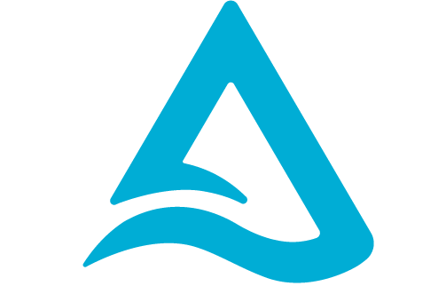
Challenge: Which open table format to pick?
Hudi
Delta Lake
Iceberg
Notes:
But lately, we’ve seen that many customers have had to make an anxiety-inducing decision between three different open table formats: Hudi, Delta and Iceberg
Am I picking the right format? What tools support which? Will I be going through a one-way door?
These are all good questions, but they’re slow towards the open data lakehouse
We think there’s a better way forward…

Slide 89





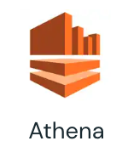










Apache Hudi
Delta Lake
Apache Iceberg
Metadata
Used for transactional source of truth, concurrency control, etc.
Metadata
Metadata
Metadata
Parquet
Parquet
Parquet
Connector Ecosystem
Microsoft
Fabric
Notes:
All three table formats store data in the Parquet file format,
but diverge in how they store additional metadata

Slide 90
Delta Universal Format
Delta Lake
With UniForm
Metadata
Used for transactional source of truth, concurrency control, etc.
Metadata
Parquet
Data
All formats use Parquet!
Connector Ecosystem
Microsoft
Fabric
Notes:
Data stored in Delta accessed as if it were Iceberg or Hudi

Slide 91
How UniForm works
Metadata automatically generated to make Delta accessible as Iceberg/Hudi
Parquet files remain the same
Metadata is co-located with data
Delta Lake with UniForm
Data stored in Delta can be read as if it were Iceberg or Hudi
Notes:
Delta does the work of unifying table formats so customers don’t have to.
What if the format could easily translate itself to other formats? We thought to ourselves, in this age of LLMs, translation shouldn’t be that hard to do. And it isn’t!

Slide 92
The UniForm experience
Access Delta as Hudi or Iceberg
From any Hudi or Iceberg reader
No additional cost
No new SKUs or pricing
Single copy of data
No need to duplicate data across formats
Open Source
In Delta 3.0 release
Set and forget enablement
No manual conversions, no new clusters
Unity Catalog support
UC now exposes Iceberg REST API Catalog interface
Notes:
Access Delta as Iceberg or Hudi readers
One copy of the data
One-time enablement: no manual conversions
No new SKUs or pricing
Open Source in Delta 3.0 release
It’s compatible with Unity Catalog

Slide 93
Is UniForm fast?
Delta write performance
Lower is better
<5%
UniForm OFF
UniForm ON
Notes:
Access Delta as Iceberg or Hudi readers
One copy of the data
One-time enablement: no manual conversions
No new SKUs or pricing
Open Source in Delta 3.0 release
It’s compatible with Unity Catalog

Slide 94
Is UniForm fast?
Delta write performance
Lower is better
Read performance in Snowflake (OOB)
Lower is better
±10%
<5%
UniForm OFF
UniForm ON
Iceberg
SNOWFLAKE
UniForm DATABRICKS

Slide 95
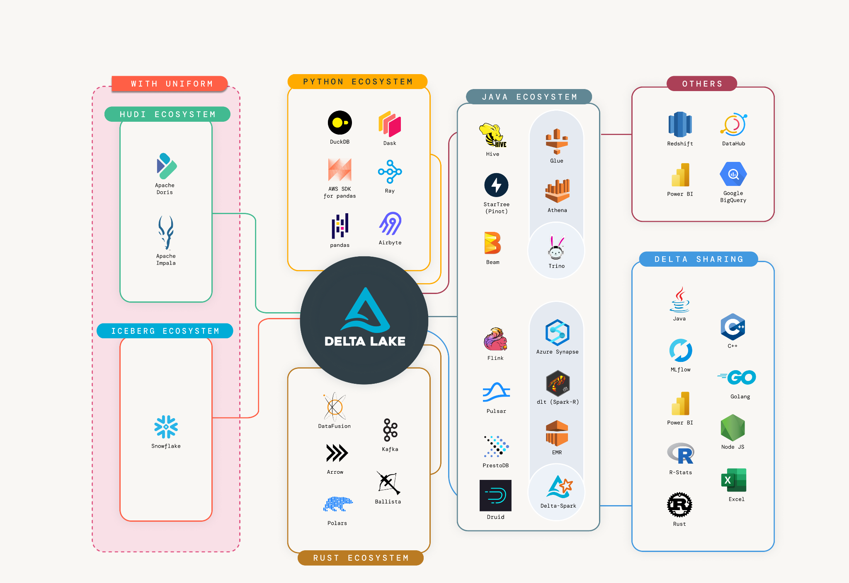
Delta Lake supports all ecosystems
Support for any architecture you choose today or in the future
Notes:
UniForm extends Delta Lake rich connector ecosystem to include the Iceberg and Hudi ecosystems
This provides the flexibility to support not only your current architecture, but also any engine you may want to choose in the future

Slide 96
Delta Format Best Practices
Differences between Delta Lake and Parquet on Apache Spark: Do not manually modify, add, or delete Parquet data files in a Delta table, as this can lead to lost data or table corruption. Instead, use a WHERE clause for data skipping, such as spark.read.table("<table-name>").where("date = '2017-01-01'").
Improve performance for Delta Lake merge: You can reduce the number of files by enabling optimized writes. Databricks can automatically detect if a Delta table has frequent merge operations that rewrite files and may choose to reduce the size of rewritten files in anticipation of further file rewrites in the future.
Enhanced checkpoints for low-latency queries: Delta Lake writes checkpoints as an aggregate state of a Delta table at an optimized frequency. These checkpoints serve as the starting point to compute the latest state of the table. Without checkpoints, Delta Lake would have to read a large collection of JSON files (“delta” files) representing commits to the transaction log to compute the state of a table.
Manage column-level statistics in checkpoints: Delta Lake doesn’t perform expensive JSON parsing to obtain column-level statistics. Parquet column pruning capabilities significantly reduce the I/O required to read the statistics for a column.
Use data skipping: To achieve this, data skipping information is automatically collected when you write data to a Delta table. Delta Lake on Databricks uses this information (minimum and maximum values) at query time to provide faster queries.
Use Z-ordering or Liquid Clustering: These techniques collocate related information in the same set of files. This co-locality is automatically used on Databricks by Delta Lake data-skipping algorithms, significantly reducing the amount of data Delta Lake must read.

Slide 97
Delta Format Best Practices Contd..
Design for failure: Use a data format that supports ACID transactions. ACID transactions are a critical feature for maintaining data integrity and consistency. Delta Lake is an open-source storage framework that provides ACID transactions as well as schema enforcement, scalable metadata handling, and unifies streaming and batch data processing.
Optimize performance of Delta tables using dbt post hooks: ZORDER - Colocate column information in the same set of files so that Delta Lake data-skipping algorithms reduce the amount of data that needs to be read for queries.
Avoid cloud versioning: Since Delta Lake maintains version history, you should avoid using cloud version control mechanisms, like S3 versioning on AWS. Using cloud version controls in addition to Delta Lake can result in additional storage costs and performance degradation.
Use the OPTIMIZE statement: This optimizes the layout of the Delta Lake data files. Optionally you can Z-ORDER the data to colocate the related data in the same set of files.

Slide 98
Unity Catalog

Slide 99










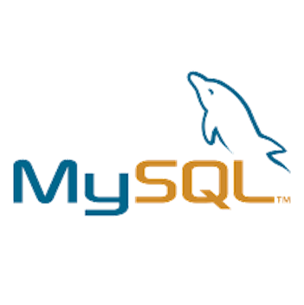








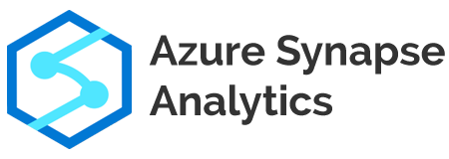


Databricks Lakehouse unifies data and AI governance
External Compute Platforms
BI & Data Warehousing
Data Engineering
Data Streaming
Data Science & ML
Open Interfaces
Databricks Unity Catalog
One governance model for structured and unstructured data + AI
Cloud Data Lake
All structured, semi-structured, and unstructured data
External Catalogs
External Data Sources

Slide 100





Databricks Unity Catalog
Unified governance for data and AI
Unified visibility into data and AI
Single permission model for data and AI
AI-powered monitoring and observability
Open data sharing
Databricks Unity Catalog
Discovery
Access
Controls
Lineage
Monitoring
Auditing
Data
Sharing
Tables
Files
Models
Notebooks
Dashboards

Slide 101
Databricks Unity Catalog
Unified governance for data, analytics and AI
Map, secure and audit data across clouds
Open data sharing and collaboration
Seamless data observability and quality
Improved productivity and discoverability
Optimized performance and reduced cost
Lakehouse Platform
Data
Warehousing
Data Engineering
Data Streaming
Data Science
and ML
Unity Catalog Fine-grained governance for data and AI
Delta Lake
Data reliability and performance
Cloud Data Lake
All structured and unstructured data
Notes:
Most important part of a house is a strong foundation
by adopting it you have these listed benefits but also it unlocks other innovations (system tables for observability)
UC is free

Slide 102
Unity Catalog - Key Capabilities
Centralized metadata and user management
Centralized data access controls
Data lineage
Data access auditing
Data search and discovery
Secure data sharing with Delta Sharing
Unity Catalog
Databricks Workspace
Databricks Workspace
GRANT … ON … TO …
REVOKE … ON … FROM …
Catalogs, Databases (schemas), Tables, Views, Storage credentials, External locations
Notes:
So today we’ll discuss these key capabilities of Unity Catalog and some of the broader pattern changes that Unity Catalog as a service and paradigm shift bring to the Databricks ecosystem.
Some of those include:
Centralized metadata and user management
Centralized data access controls
Data lineage ^{Private Preview}
Data access auditing
Data search and discovery ^{Coming Soon}
Secure data sharing with Delta Sharing

Slide 103
All your metadata, in one place
One metadata layer across file and database sources superpowers governance
Without Unity Catalog
With Unity Catalog
Databricks Workspace 1
Databricks Workspace 2
Unity Catalog
User Management
Metastore
Foreign Databases
Access Controls
User Management
User Management
Metastore
Metastore
Databricks Workspace
Databricks Workspace
Access Controls
Access Controls
Clusters SQL Warehouses
Clusters SQL Warehouses
Clusters SQL Warehouses
Clusters SQL Warehouses
Notes:
So prior to Unity Catalog, the concept of a workspace was somewhat monolithic. This was for 3 principal reasons
You had to define users and groups at each workspace, either manually or through some SCIM Synchronization with your Federated Identity Platform.
You also by default had a metastore that could only be used with one workspace.
In addition to that, all access controls existed only in the workspace scope and couldn’t be used outside of that workspace without duplication.
At the end of the day, this results in a higher operational overhead and a lack of efficiency, as well as an inconsistent and non centralized view of your data estate and potentially inconsistent controls on your data
With Unity Catalog, we move these 3 concepts out of workspaces, and into a new object that works orthogonally across all workspaces. This object is called an Account. The Account, including the Account Console, which is a user interface to control the Account, lives purely in the control plane, and as such there is NO customer compute associated with these objects and services.
You will typically have one Account per organization (i.e. your entire company) per cloud provider. Now you can setup data, controls, and user management in one place, and use them across multiple workspaces.

Slide 104
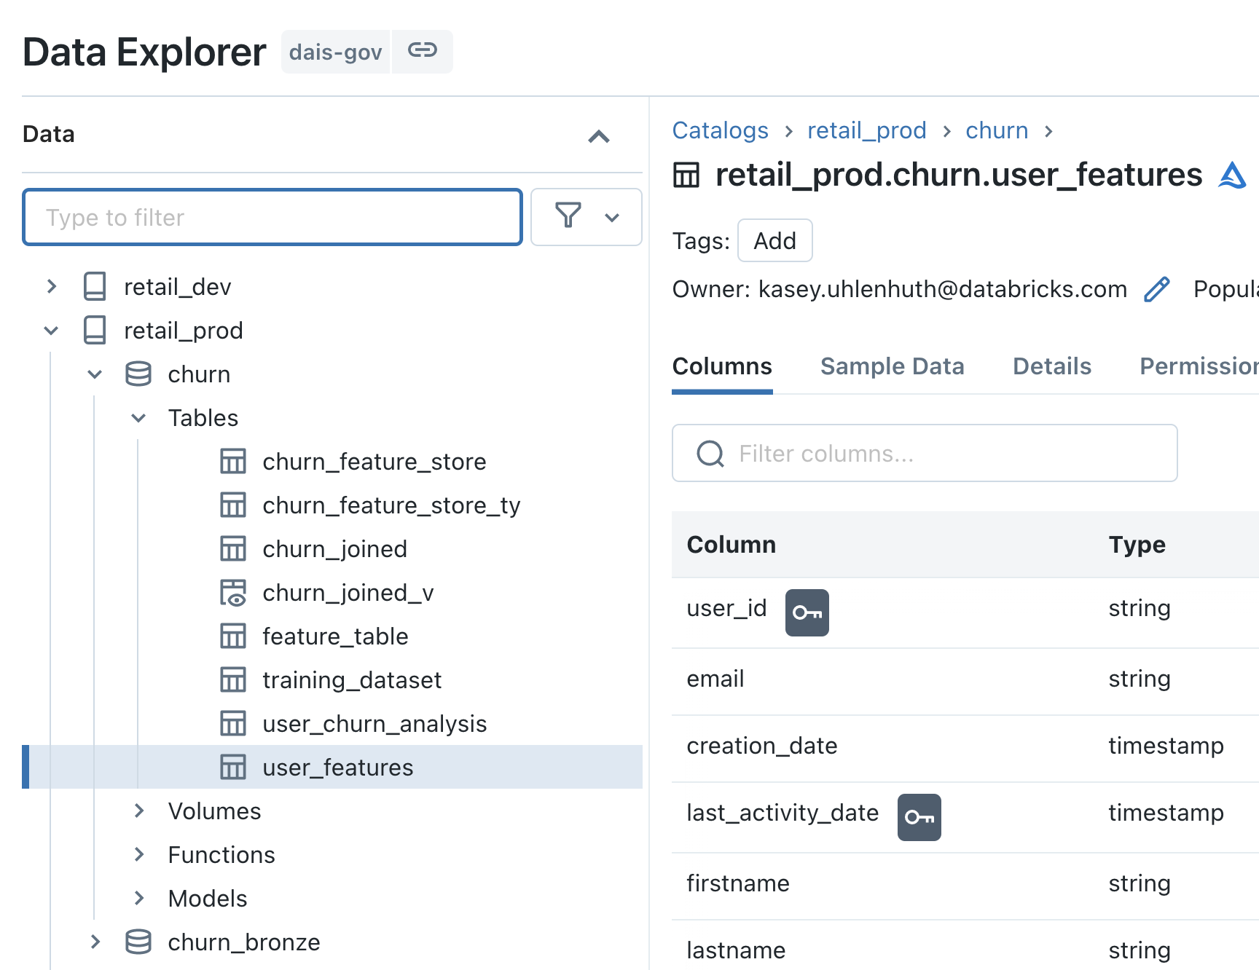
Governed namespace across file and database sources
Access legacy metastore and foreign databases powered by Lakehouse Federation
Unity Catalog
hive_metastore
(legacy)
Foreign Catalog
Catalog 1
default (database)
Foreign Schema
Schema 1
customers
(table)
Foreign Table
External Table
Models/ Functions
Views
Managed / Ext Tables
Volumes
SELECT * FROM main.paul.red_wine; -- <catalog>.<database>.<table>
SELECT * FROM hive_metastore.default.customers;
SELECT * FROM snowflake_warehouse.some_schema.some_table;

Slide 105
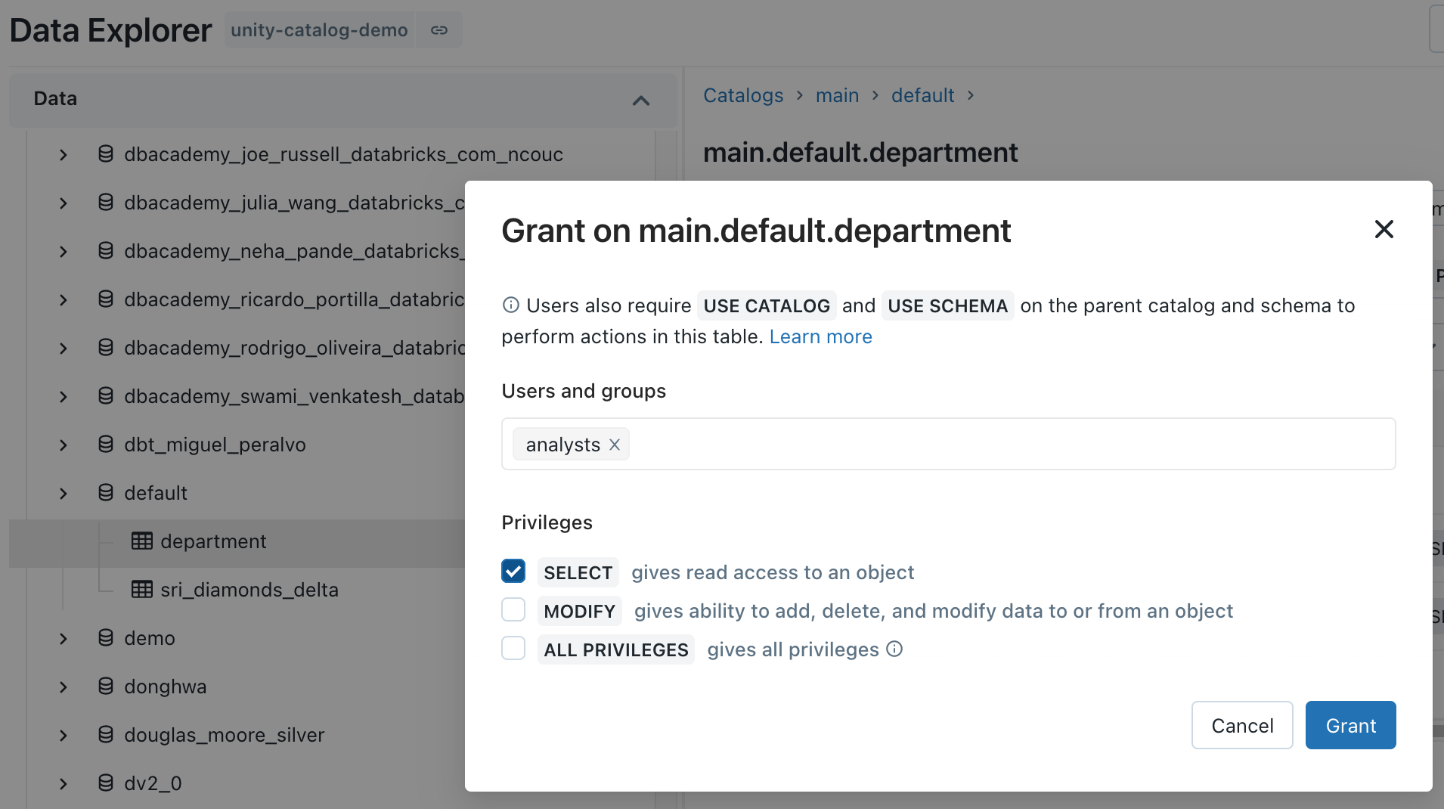
Centralized Access Controls
Centrally grant and manage access permissions across workloads
Using ANSI SQL DCL
Using UI
GRANT <privilege> ON <securable_type> <securable_name> TO `<principal>`
GRANT SELECT ON iot.events TO engineers
Choose permission level
‘Table’= collection of files in S3/ADLS
Sync groups from your identity provider
Notes:
One of the tenants that we embrace as a company, is to make things simple. ANSI SQL DCL, the data control language specification part of ANSI SQL, is a familiar interface for RDBMS users and admins alike. This allows you to grant permission scopes on securable objects like tables or locations to principals like groups, users, or service principals.
The same level of functionality is available via our UI in an easy to use point and click manner, which helps for easy access auditing on the spot.
In addition to that, we offer the ability to set these ACLs on objects via our RESTful APIs, which means that anything, from legacy entitlement request processes to modern dev/sec/ops initiatives can be supported and powered by Unity Catalog.
The interesting thing to note with API and UI based ACL grants, is that they are done outside the context of compute, purely through our control plane APIs.

Slide 106
Row Level Security and Column Level Masking
Provide differential fine grained access to datasets
Only show specific rows
Mask or redact sensitive columns
CREATE FUNCTION <name> ( <parameter_name > <parameter_type> .. )
RETURN {filter clause whose output must be a boolean}
CREATE FUNCTION <name> (<parameter_name>, <parameter_type>, [, <column>...])
RETURN {expression with the same type as the first parameter}
CREATE FUNCTION us_filter(region STRING)
RETURN IF(IS_MEMBER(‘admin’), true, region=“US”);
ALTER TABLE sales SET ROW FILTER us_filter ON region;
CREATE FUNCTION ssn_mask(ssn STRING)
RETURN IF(IS_MEMBER(‘admin’), ssn, “****”);
ALTER TABLE users ALTER COLUMN table_ssn SET MASK ssn_mask;
Test for group membership
Assign reusable filter to table
Test for group membership
Assign reusable mask to column
Specify filter predicates
Specify mask or function to mask

Slide 107





Managed Data Sources & External Locations
Simplify data access management across clouds
Audit log
Unity Catalog
External Locations & Credentials
Access Control
Cloud Storage (S3, ADLS, GCS)
Managed tables
Managed Data Sources
Managed container / bucket
Cluster or SQL endpoint
User
External tables
External container / bucket
…
External Locations
Files in Cloud Strg
External container / bucket
Notes:
Credentials to access to cloud storage now live in Unity Catalog metastore; not defined at cluster level anymore, and not as mount points either.
When you set up a Unity Catalog Metastore for the first time, you will associate a managed data source with that metastore. This managed data source is a container or bucket that will only be read from and written to via Databricks, through Unity Catalog. Along with this managed datasource is a default credential object that will be used for Unity to broker access to this data. I will explain the request path of how Unity Catalog does this in the next slide.
But to flesh out these concepts, if you create a table in legacy HMS, and you don’t specify a location for that table, it by default will be stored in DBFS. This is known as a managed table in Hive and the default location in Databricks is DBFS.
In Unity, this is very similar, we have a concept of a managed table. that when you create a table without a specified location, it will use the managed data source associated with your metastore to store the table. Managed tables have to be Delta Tables.
There is another first class primitive object within Unity called an External Location. An External Location is a combination of two things, a cloud URL and a Credential. It is an object that can have it’s own ACLs on it and allows users to READ/WRITE or CREATE TABLEs inside it. This is how users can get access to arbitrary files in cloud storage.
If you create a table using a location that belongs to an external location that you have the CREATE TABLE right on, you can now federate this externally defined table to anywhere in your metastore hierarchy. External tables can be delta, parquet, avro, orc, or a number of other supported formats.
Prior to Unity Catalog Credentials to access cloud storage like S3 or ADLS were defined at the cluster or endpoint or in a passthrough mechanism based on the user’s cloud identity.
With Unity Catalog, those Credentials live as first class primitive objects in your Unity metastore. They have ACLs on them like any other object, but they are typically not used by users directly.

Slide 108
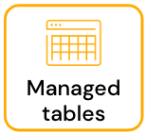
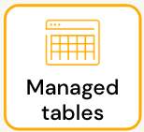
Default access to storage by catalog or schema
Use managed data sources for data isolation or cost allocation
Unity Catalog
Cloud Storage (S3, ADLS, GCS)
Metastore
Managed container / bucket
1) Store at the metastore
Catalog1
Schema1
Catalog2
Managed container / bucket
2) Store at the catalog
Schema2
3) Store at the schema
Schema3
Managed container / bucket

Slide 109

Access data from specified environments only
Restrict data access by environment or purpose
Catalogs
Workspaces
Groups
dev
dev_ws
Developers
staging
staging_ws
Testers
Metastore
Access to data and availability of data can be isolated across workspaces and groups
prod
prod_ws
Analysts
bu_1_dev
bu_dev_stg_ws
BU Developers
bu_1_staging
BU Testers
bu_1_prod
bu_prod_ws
BU Users

Slide 110
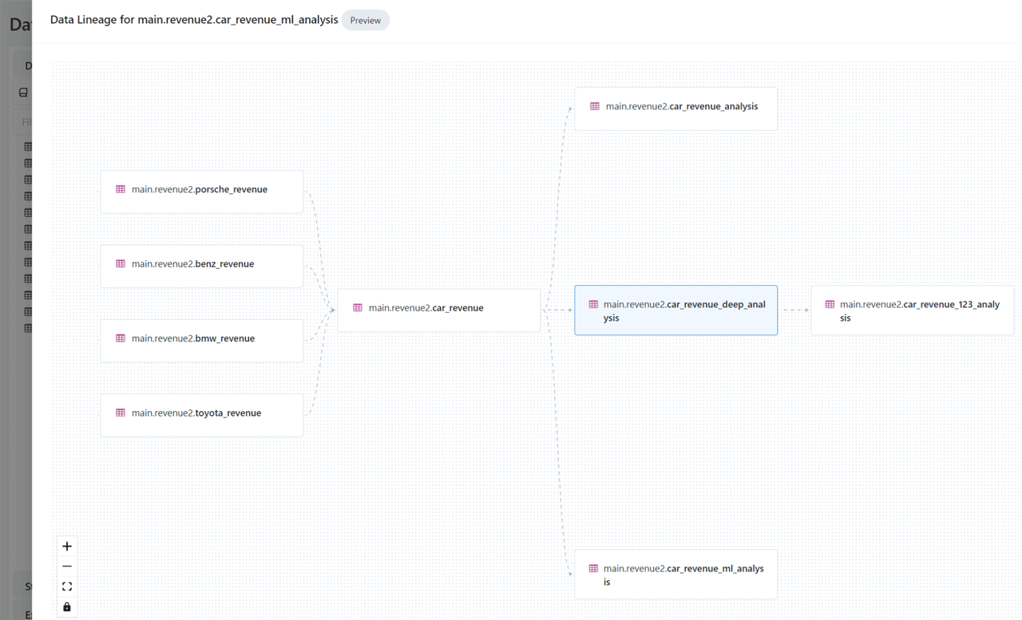
Automated lineage for all workloads
End-to-end visibility into how data flows and consumed in your organization
Auto-capture runtime data lineage on a Databricks cluster or SQL warehouse
Track lineage down to the table and column level
Leverage common permission model from Unity Catalog
Lineage across tables, dashboards, workflows, notebooks
Notes:
So lineage is pretty exciting! We now have the ability to automatically capture runtime lineage on clusters and sql endpoints down to the column level. So that means if you create a derivative data set based on another dataset through the Spark APIs, you will be to see that relationship in an immutable form through our UI and APIs.

Slide 111
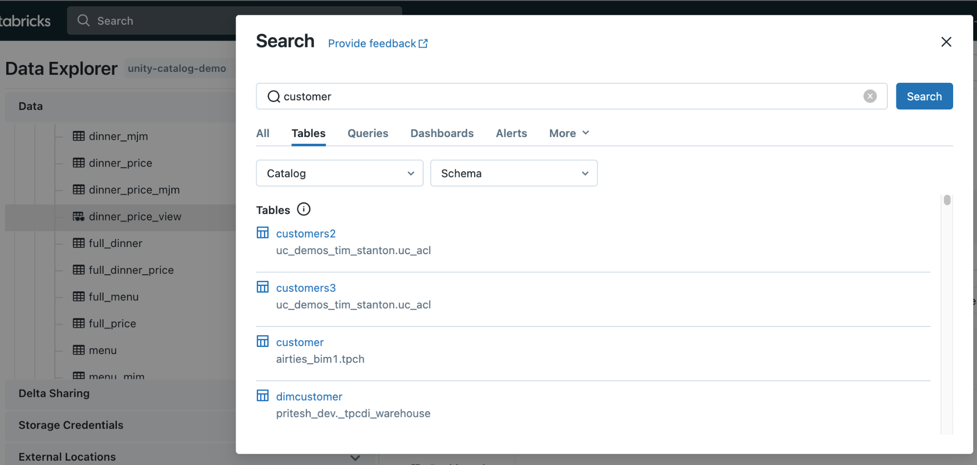
Built-in search and discovery
Accelerate time to value with low latency data discovery
UI to search for data assets stored in Unity Catalog
Unified UI across DSML + DBSQL
Leverage common permission model from Unity Catalog
Apply semantic tags to data and search across tags
Notes:
We’ve also introduced Data Discovery, which is an integrated User Interface to discover assets in Unity Catalog. This is a unified UI across personas and it leverages the common permission model from UC, so if you don’t have access to see or read a table, it will not show up in your search results.

Slide 112
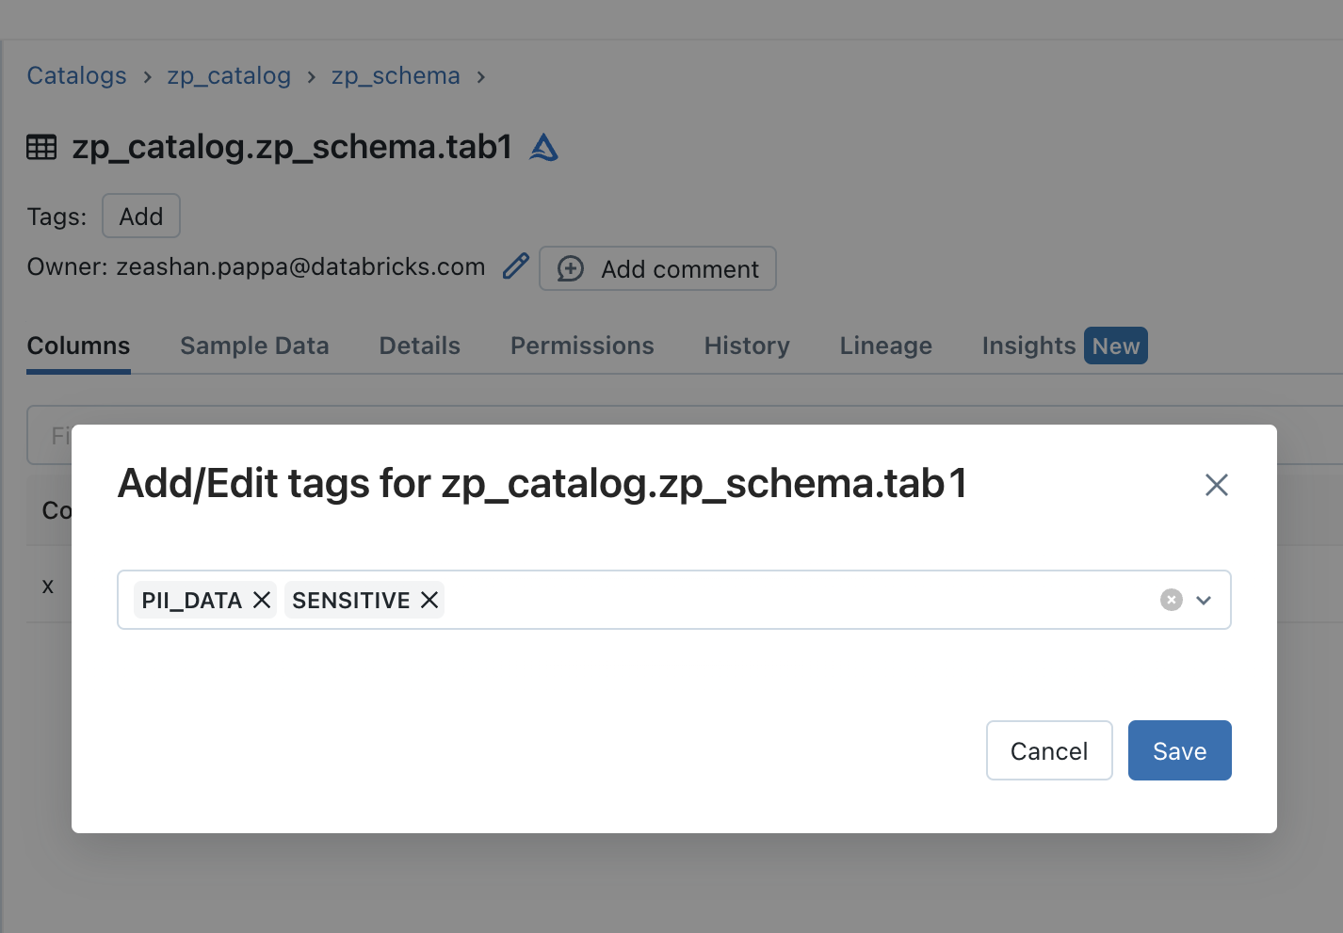
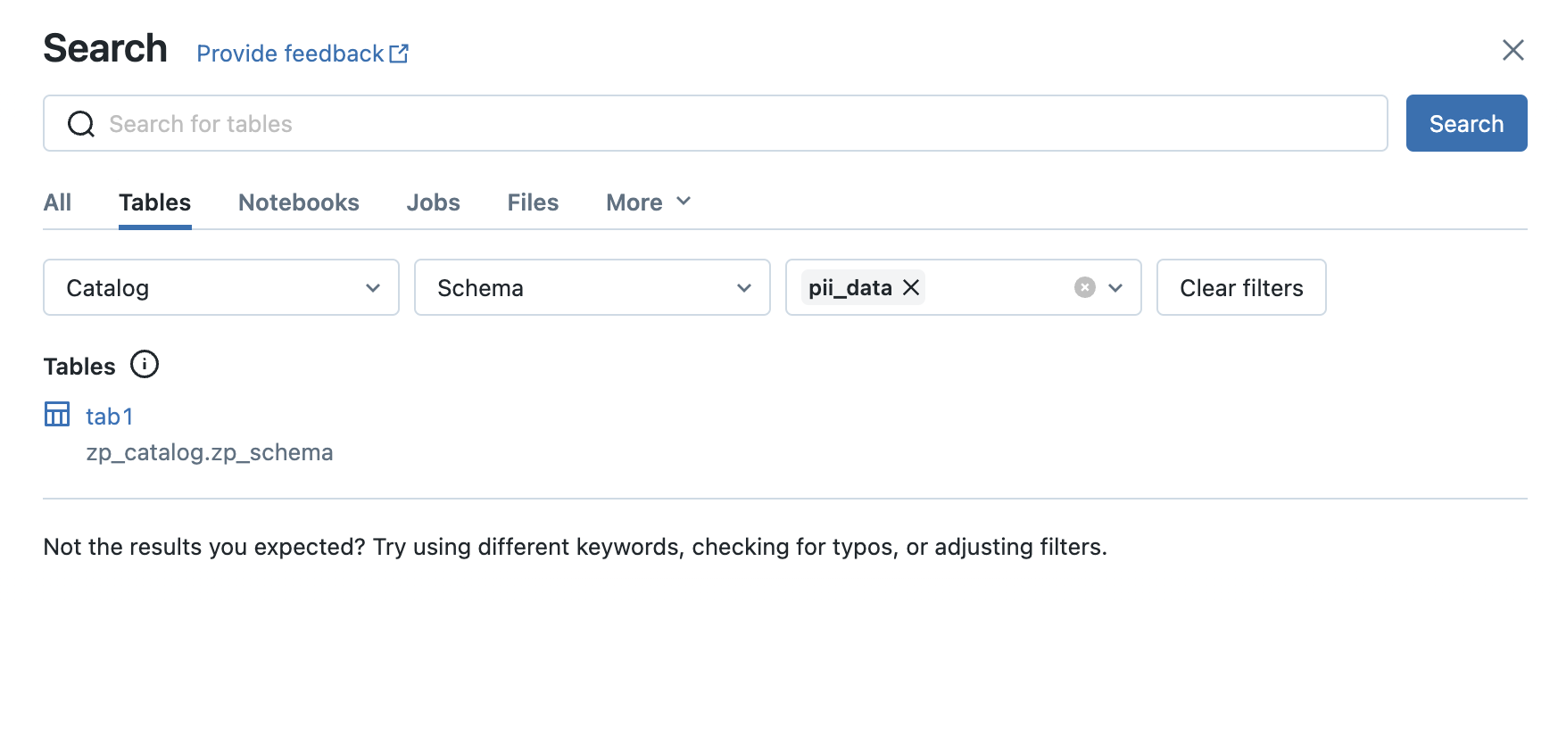
Discovery Tags
Semantic layer for your lakehouse
Problem
Searching for data assets in business terms or generally agreed upon taxonomies usually requires additional catalog tools.
Solution
Discovery Tags allow you to tag Column, Table, Schema, Catalog objects in UC
Integrated search mechanism in UC allows you to search for objects by tag.
Tag your data
Search based on tags

Slide 113







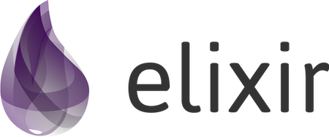


Delta Sharing
Open data collaboration across clouds & regions
DATA CONSUMER ON DATABRICKS
Data Consumer #1
DATA PROVIDER ON DATABRICKS
✔ Access shared Views
Data Provider
Databricks-managed sharing connection
✔ Unified data governance
✔ SQL API and UI
✔ Unified data governance
✔ Partition filtering
✔ IP access/cloud region restrictions
DATA CONSUMER
✔ SQL API and UI
Data Consumer #2
Not on Databricks
Token-based protocol
Notes:
Secure sharing without replication
We’re very much excited to announce that Delta Sharing on Databricks is officially GA on AWS and Azure. GCP will follow along the same schedule as Unity Catalog.
Some of the BIG NEW GA features include:
Create and manage providers, recipients, and shares with a simple to use user interface.
Query changes to data or share incremental versions with Change Data Feeds.
Other notable GA features include:
Delta Sharing internally within the same Databricks account is enabled by default.
Enforce separation of duties by delegating management of Delta Sharing to non-admins.
AWS
Private Preview - N/A
Public Preview - N/A
GA - Q3 2022
AWS GovCloud
Private Preview - TBD
Public Preview - TBD
GA - TBD
Azure
Private Preview - N/A
Public Preview - N/A
GA - Q3 2022
Azure Government
Private Preview - TBD
Public Preview - TBD
GA - TBD
Azure Mooncake (CHINA)
Private Preview - TBD
Public Preview - TBD
GA - TBD
GCP
Private Preview - Q4 2022
Public Preview - TBD
GA - TBD

Slide 114
Metastores

Slide 115
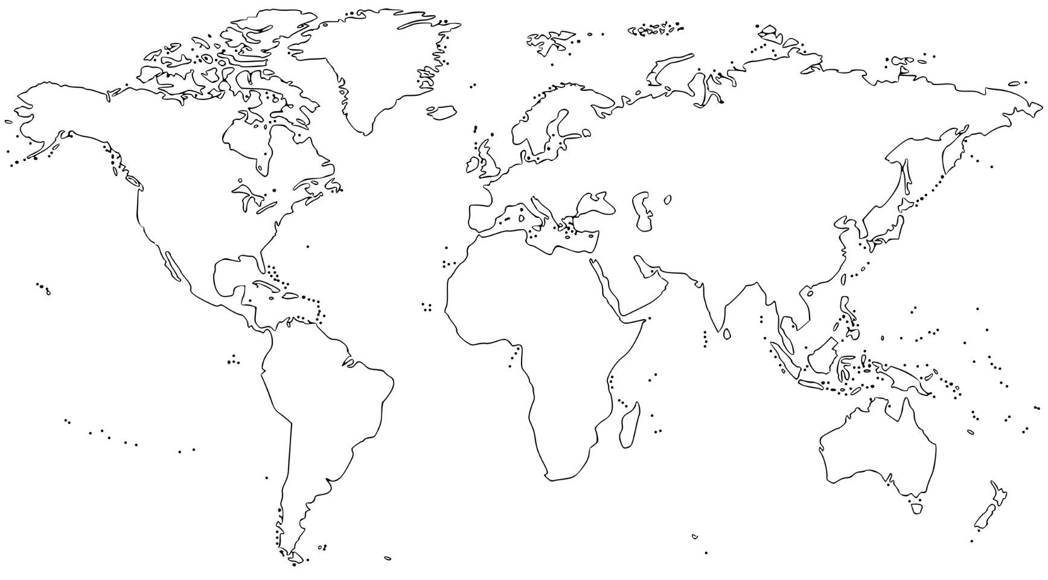

Metastores
Region B
dev workspace
staging workspace
prd Workspace
Metastore
Region A
dev workspace
staging workspace
prd Workspace
Metastore
Notes:
Metastores can share data, if needed, using Databricks-to-Databricks Delta Sharing, a pattern which can also be applied across multiple clouds.
Applying this scheme, you can register tables from metastores in different regions. In this example, we are sharing tables from Region A with Region B. Keep in in mind the following:
Since delta shares are read-only, tables will appear as read-only in the consuming metastore, or in this case metastore B.
Access control lists do not cross Delta Sharing, so access control rules need to be set up in the destination, in the case metastore B.
Apply this scheme sparingly, for tables that are infrequently accessed, since you will be responsible for egress charges across cloud regions. If you have frequently accessed data it may make sense to copy it across regions via a batch process and then query locally, as opposed to querying across regions.
It may be tempting to concoct a different approach using external tables; that is, create a storage credential in metastore B that directly connects to cloud storage referenced by the tables in metastore A. While this is possible, Databricks strongly advises against this. There is a risk here in that any changes to table metadata in one metastore will not be propagated to the other metastore, leading to potential consistency issues.

Slide 116
Identity Federation

Slide 117

User Management at the account level
When UC metastore is assigned to workspace, identity federation is activated
Unity Catalog
User Management
User Management
Metastore
Databricks Workspace
Databricks Workspace
Clusters SQL Warehouses
Clusters SQL Warehouses

Slide 118
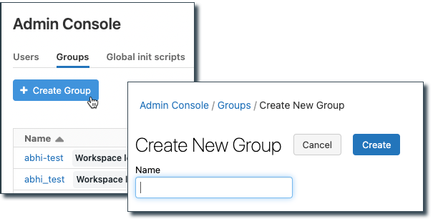
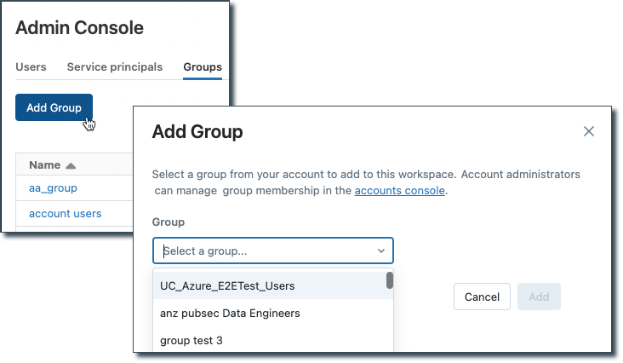
Identity Federation Enrollment with UC
Behavior change for group administration after connecting to UC
Before
After
Workspace admins can create workspace local groups
Groups are created at the account level and added to the workspace(s)
Notes:
Point out that the button changes from “+ Create Group” to “Add Group”. This change applies whether you are using SCIM provisioning or not.

Slide 119
Data Seggregation

Slide 120
Catalogs for Data Segregation
Environment scope
dev
staging
prod
Business unit + environment scope
bu1_dev
Metastore
bu1_staging
bu1_prod
Sandboxes
team1_sandbox
team2_sandbox
Notes:
Using Catalogs to provide segregation across your organization’s information architecture can be done in a number of different ways. Examples include scoping by environment scope (like dev, staging and prod), by team, business unit, or any combination of these things. Catalogs can also be used to designate sandboxes; that is, an internal-only area to create temporary datasets for internal use.
In short:
use catalogs to organize your data objects by environment scope, business unit, or whatever combination of these you need. Within each catalog remains a two-level namespace with which most analysts and SQL developers will be familiar.
Grant USAGE to applicable catalogs only to those groups who should have access
Ensure ownership of production catalogs and schemas are on groups, not individuals

Slide 121
External Storage

Slide 122
Storage Credentials and External Locations
Storage Credential
External Location
Enables Unity Catalog to connect to an external cloud store
Examples include:
IAM role for AWS S3
Managed Identity for Azure Storage
Service Account for Google Cloud Storage
Cloud storage path + storage credential
Self-contained object for accessing specific locations in cloud stores
Fine-grained control over external storage
Notes:
No more mount points /mnt!
Recall that Storage credentials represent authentication with a cloud storage container, where external locations build on storage credentials by adding a cloud storage path.

Slide 123
Storage Credentials and External Locations
One Storage Credential reused across
Multiple External Locations
Storage credential
External
location 1
user1/
users/
External
location 2
user2/
/
External
location 3
tables/
shared/
External
location 4
tmp/
Notes:
This example represents the filesystem hierarchy of a single cloud storage container. Storage credentials provide the same access level control as external locations, but apply to the entire namespace. It’s normally desirable to predicate control over individual paths, which can only be accomplished using external locations.

Slide 124
Storage Credentials and External Locations
One Storage Credential reused across
Multiple External Locations
Storage credential (Metastore root service account)
External
location 1
ehs/
unity_catalog/
External
location 2
hmh/
lab GCS/
Notes:
This example represents the filesystem hierarchy of a single cloud storage container. Storage credentials provide the same access level control as external locations, but apply to the entire namespace. It’s normally desirable to predicate control over individual paths, which can only be accomplished using external locations.

Slide 125
Comparison of Managed and External UC Tables
Characteristic | Managed | External
DROP Table | Deletes the associated data | Does not delete the data
Data Location | Unity Catalog-generated path using whichever is found first: Location specified for Schema, or Location specified for Catalog, or UC Metastore default root storage location | The data file path specified by the LOCATION keyword in your create table statement
Performance Optimizations | Auto Tune & Maintenance feature will be supported for both managed & external tables but with different timelines (i.e., managed tables will be supported first)
Data Format Support | DELTA | DELTA, CSV, JSON, AVRO, PARQUET, ORC, TEXT
Create Table Syntax | CREATE TABLE [<catalog>.][<schema>.]<table> ( <column_specification>); | CREATE TABLE [<catalog>.][<schema>.]<table> ( <column_specification>) LOCATION ‘<cloud_specific_storage_path>';
Migration to Unity Catalog | Rewrite tables to Unity Catalog required, such as DEEP CLONE | Register table metadata to Unity Catalog while keeping table data in-place; SYNC
Notes:
You can use both managed and non-managed tables with Unity Catalog (UC).
Managed tables are generally easier to use for business analysts who create and delete tables for analysis because the cloud data files backing the table are deleted when the table is dropped. This behavior is more intuitive, is consistent with traditional DBMS, and much easier to work with.
Managed tables also simplify things for data engineers and data scientists because UC External Locations simplifies the specification of storage semantics and the management of cloud storage credentials while offering better control and governance over the data.
Initially the data files for UC managed tables were stored only in the UC metastore’s default storage location. However, since November 2022, you can optionally configure a default Managed Location for UC catalogs and schemas which offers both the benefits of managed tables and the flexibility of defining where managed table data is located by default.
To leverage this feature, first setup an External Location pointing to your S3/ADLS storage location and then create a schema and/or catalog with the managed location option (you can do this with notebook code or by using the Data Explorer UI).
Most specific location takes precedent
Roadmap deck for Auto Tune https://docs.google.com/presentation/d/1IPrUZCxaoiO7Y85HyAdoBjSxqNM0noSTyDqVaKz8vp8/edit#slide=id.g136fc63b5ac_15_0

Slide 126
Storage Isolation: Per Catalog & Schema Locations
Set up External Location to cover desired path eg s3://mymanagedstorage/tables
CREATE CATALOG myNewCatalog
MANAGED LOCATION s3://mymanagedstorage/tables;
CREATE TABLE myNewCatalog.mySchema.table (...)’;
Data will be stored in s3://mymanagedstorage/tables/* as a Managed Table
Notes:
Storage-catalog isolation

Slide 127
Cluster Security Mode

Slide 128
Clusters
Security modes
Modes supporting Unity Catalog
Modes not supporting Unity Catalog
Single user Multiple language support, not shareable
User isolation Shareable, Python and SQL, legacy table ACLs
+Databricks Runtime 11+
None No security
Table ACL only Legacy table ACLs, multiple languages, shareable
Passthrough only Credential passthrough, multiple languages, shareable
Notes:
All users, regardless of whether or not they have used Databricks before, must be familiar with the new security mode parameter and its available options. For existing Databricks users, the introduction of this new parameter alleviates the previous overloading of the cluster mode parameter, thus eliminating the high concurrency cluster mode.
While there are 5 security mode options to choose from, only two are relevant as far as Unity Catalog is concerned. These are:

Slide 129





Clusters
Shared Cluster
Single User Cluster
Support concurrent users/workloads with full isolation guarantees, fine grained security
Support advanced use cases such as GPUs, distributed ML, RDDs

Slide 130
Clusters
Security mode feature matrix
Security mode | Supported languages | Legacy table ACL | Credential passthrough | Shareable | RDD API | DBFS Fuse mounts | Init scripts and libraries | Dynamic views | Machine learning
None | All |  |  | ⬤ | ⬤ | ⬤ | ⬤ |  | ⬤
Assigned aka ‘Single-User’ | All |  |  |  | ⬤ | ⬤ | ⬤ |  | ⬤
Shared | SQL Python | ⬤ |  | ⬤ |  |  | ⬤ | ⬤
Legacy table ACL | SQL Python | ⬤ |  | ⬤ |  |  | ⬤
Legacy Passthrough | SQL Python |  | ⬤ | ⬤ | ⬤ | ⬤ | ⬤
Notes:
We have provided this matrix for reference to aid in selecting an appropriate security mode, with the shaded rows representing modes that support Unity Catalog access.Your choice will be primarily driven by the type of workloads you want to run.

Slide 131
Unity Catalog Best Practices
Data Governance and Data Isolation Building Blocks: Catalogs represent a logical grouping of schemas, usually bounded by data access requirements. They are intended as the primary unit of data isolation in a typical Databricks data governance model. You may choose to have a catalog for production data and a catalog for development data, or a catalog for non-customer data and one for sensitive customer data.
Workspace and Catalog Management: If your workspace was enabled for Unity Catalog automatically, there is no metastore-level storage, and you must specify a storage location when you create a catalog. Metastore admins and catalog owners can manage access to catalogs independently of workspaces, or they can bind catalogs to specific workspaces to ensure that certain kinds of data are processed only in those workspaces.
Schema (Database) Management: Schemas, also known as databases, are logical groupings of tabular data (tables and views), non-tabular data (volumes), functions, and machine learning models. They give you a way to organize and control access to data that is more granular than catalogs.
External Tables: External tables are tables whose data lifecycle and file layout are managed using your cloud provider and other data platforms, not Unity Catalog. Typically you use external tables to register large amounts of your existing data, or if you also require write access to the data using tools outside of Databricks clusters and Databricks SQL warehouses.
Data Governance Models: Unity Catalog gives you the ability to choose between centralized and distributed governance models. In the centralized governance model, your governance administrators are owners of the metastore and can take ownership of any object and grant and revoke permissions. In a distributed governance model, the catalog or a set of catalogs is the data domain.
Organize Your Data: Databricks recommends using catalogs to provide segregation across your organization’s information architecture. Often this means that catalogs correspond to a software development environment scope, team, or business unit.
Please refer this doc for more details: https://docs.databricks.com/en/data-governance/unity-catalog/best-practices.html

Slide 132
Unity Catalog (Gilead-DnA Infra)

Slide 133
Divider Slide with Image

Slide 134
Divider Slide with Image

Slide 135
Divider Slide with Image

Slide 136
This is a Single-Column Content Slide
This is for slide content. The main type size is 20pt, and type will not resize if the amount of content on the slide surpasses the space available. Please use the global font size adjustment next to the numerical font size selector to decrease font size across the entire text area.
This is a bullet style
This is a sub-bullet
This is a third level bullet

Slide 137
This is a Single-Column Content Slide
This is for slide content. The main type size is 20pt, and type will not resize if the amount of content on the slide surpasses the space available. Please use the global font size adjustment next to the numerical font size selector to decrease font size across the entire text area.
This is a bullet style
This is a sub-bullet
This is a third level bullet

Slide 138
This is a Two-Column Content Slide
This is for slide content
Bullet style example
This is a sub-bullet
This is a third level bullet
This is for slide content
Bullet style example
This is a sub-bullet
This is a third level bullet

Slide 139
This is a Three-Column Content Slide
This is for slide content
Bullet style example
This is a sub-bullet
This is a third level bullet
This is for slide content
Bullet style example
This is a sub-bullet
This is a third level bullet
This is for slide content
Bullet style example
This is a sub-bullet
This is a third level bullet

Slide 140
Content + Infographic
Cell 1 | Cell 2 | Cell 3 | Cell 4
Put table content here. | Put table content here. | Put table content here.
Put table content here.
This slide is for copy on the left & some sort of supporting graphical image or photo on the right-hand side.

Slide 141
Content + Infographic
Cell 1 | Cell 2 | Cell 3 | Cell 4
Put table content here. | Put table content here. | Put table content here.
Put table content here.
This slide is for copy on the left & some sort of supporting graphical image or photo on the right-hand side.

Slide 142
Place Headline Here
This is a side-by-side content slide – it provides an option for simpler slide content.
You can put a few points of body copy in here and the text area will expand from the center to fill the content space.

Slide 143
Place Headline Here
This is a side-by-side content slide – it provides an option for simpler slide content.
You can put a few points of body copy in here and the text area will expand from the center to fill the content space.

Slide 144
This is a key point example. Text only.

Slide 145
This is a key point example. Text only.

Slide 146
This is a key point example. Text only.

Slide 147
This is a key point example. Text only.

Slide 148
This is a key point example. Text only.

Slide 149
This is a key point example. Text only.

Slide 150
This is a key point.
You can compare two things.

Slide 151
This is a key point.
You can compare two things.

Slide 152
Key point + add custom image

Slide 153
Full Page Image with Large Call Out

Slide 154
Full Page Image with Large Call Out

